Slide 1
Urban Flood Modelling using CityCAT Steve Birkinshaw, Vassilis Glenis and Chris Kilsby Newcastle University

Slide 2
City Catchment Analysis Tool - CityCat
CityCAT is a software tool for modelling, analysis and visualisation of surface water flooding.
It enables assessment of combined pluvial and fluvial flood risk and effects of different flood alleviation measures.
Fast, efficient and accurate - easy to use
Uses readily available data (OS Mastermap and lidar)
Includes buildings and green space and other urban features
Coupled sewer drainage network and surface flow
Newcastle upon Tyne case study (with Newcastle City Council)

Slide 3
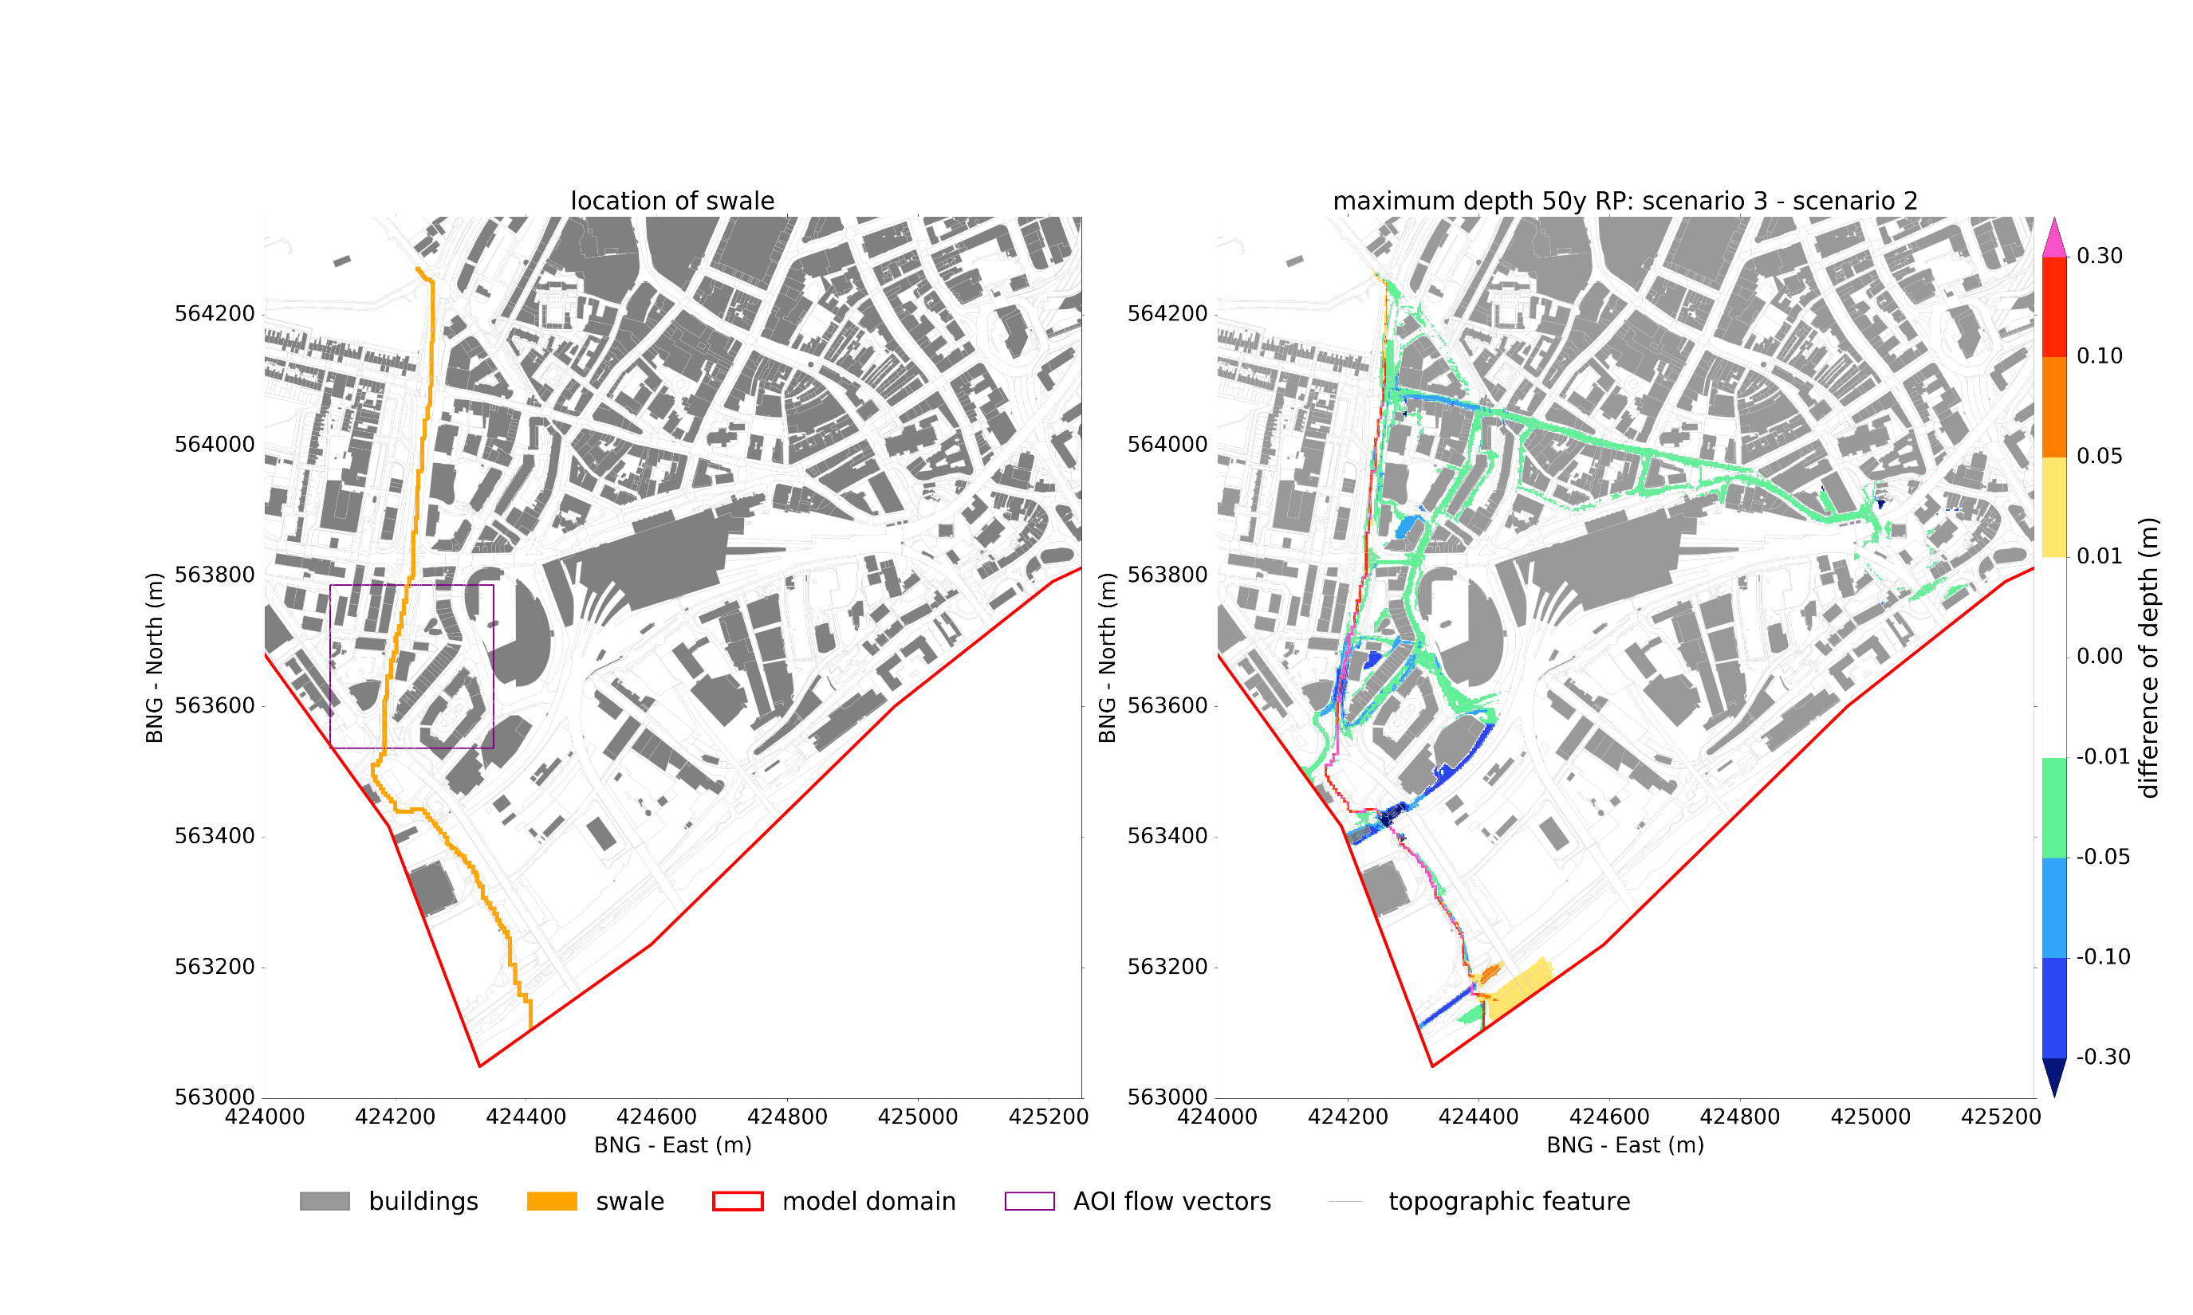
Swale
Intervention
Impact

Slide 4
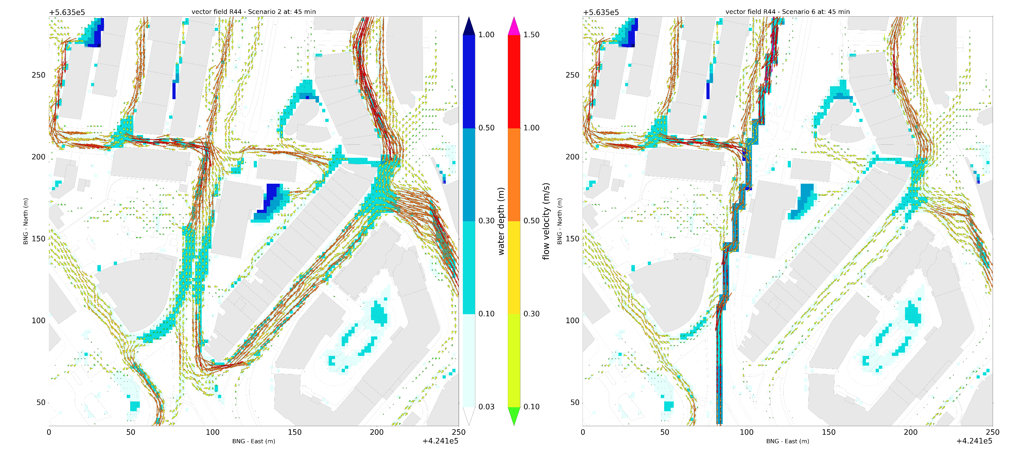
Swale – impact on flowpaths
No Swale
With Swale

Slide 6
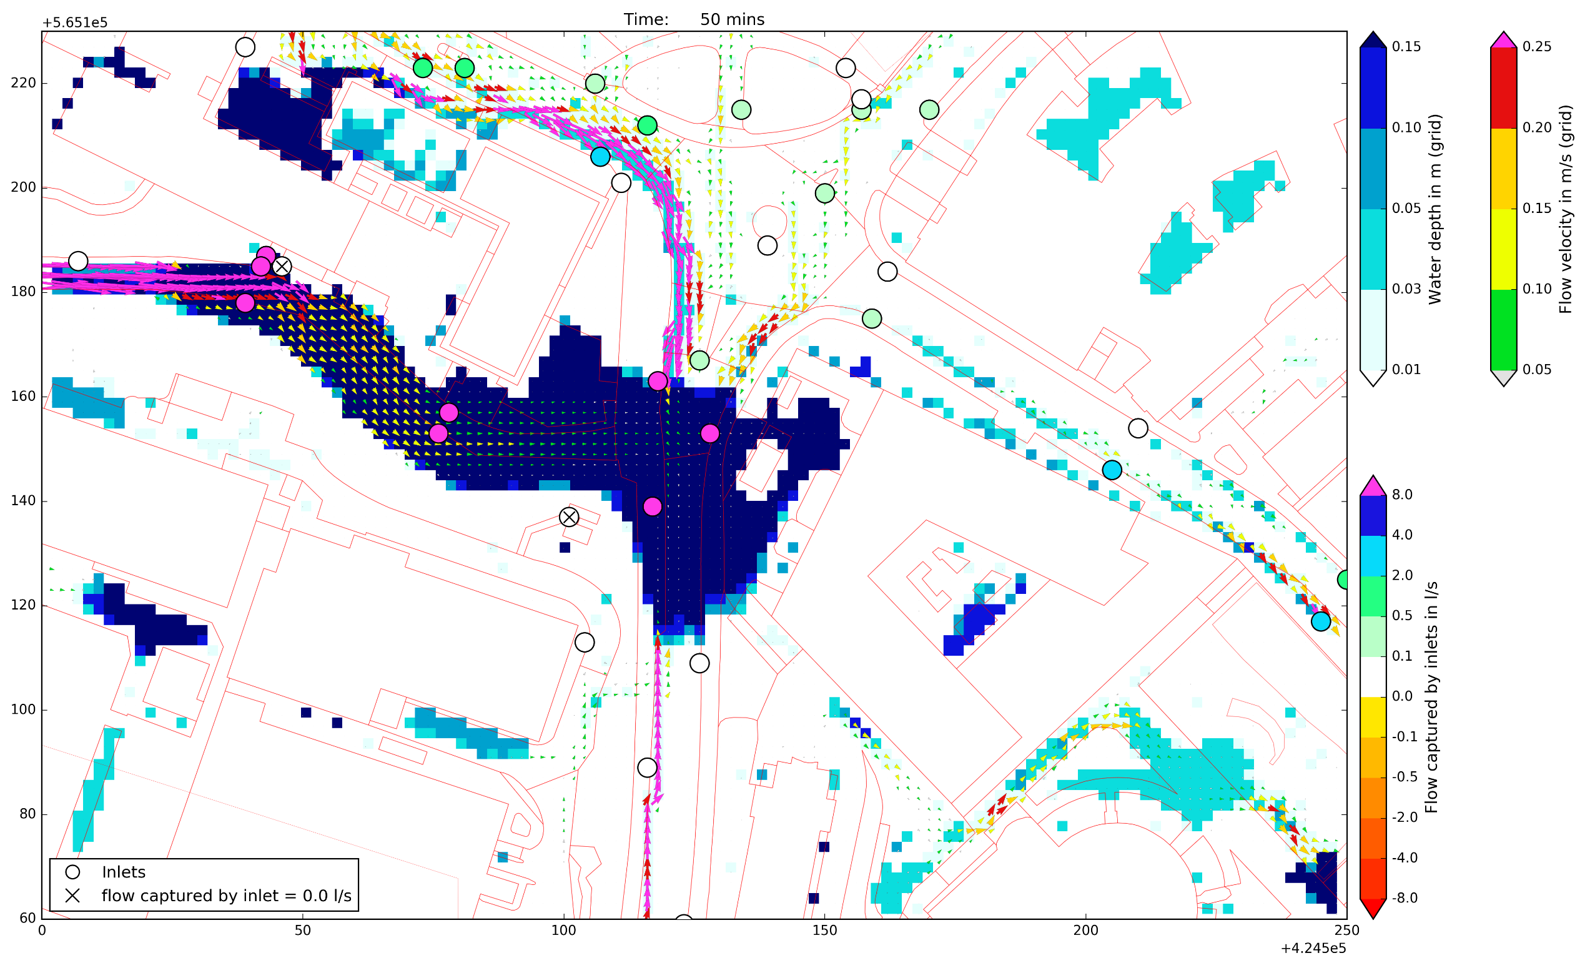
Storm drain inlets

Slide 7
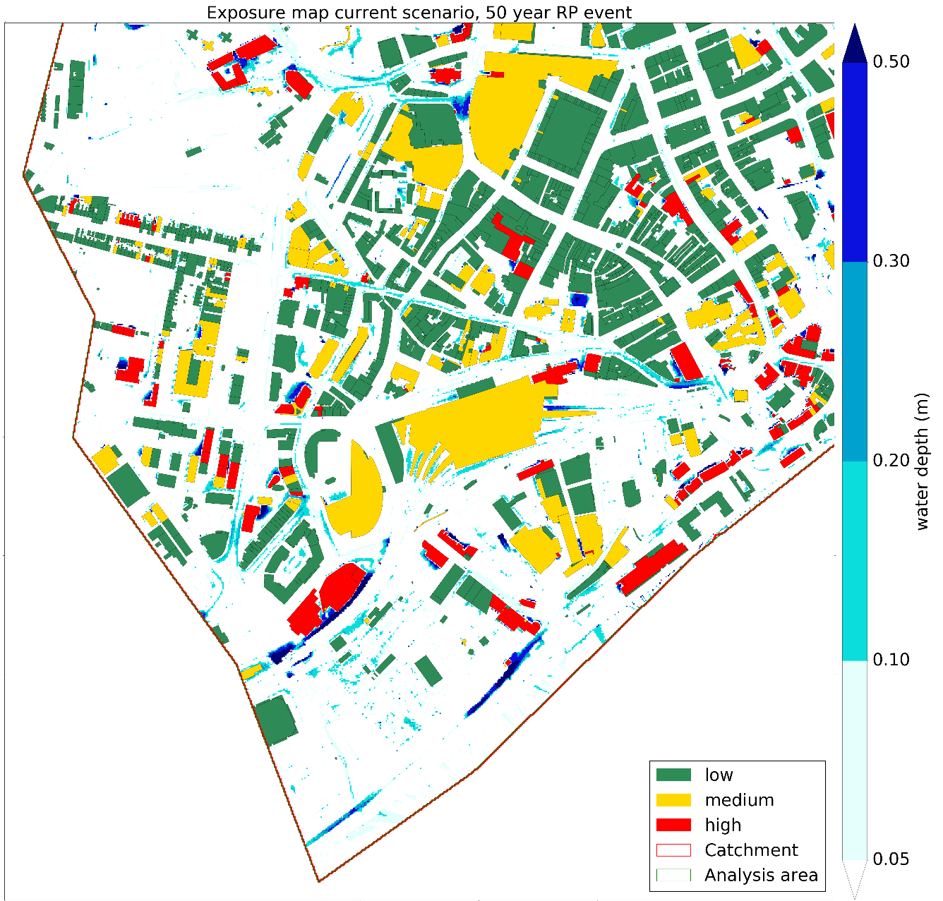
Swale length: 1.3km
Swale construction costs: £1.5 million
Damage reduction for 50 year RP event: £840,000
Exposure Tool with Depth-Damage Function
Reduced
Impact
Swale

