Slide 1
Blue-Green Cities, Urban Flood Resilience and Learning and Action Alliances
Emily O’Donnell 07.06.17
www.urbanfloodresilience.ac.uk Urban Flood Resilience @BlueGreenCities

Slide 2
January 2014 Rainfall Anomaly
December 2015 Rainfall Anomaly

Slide 3
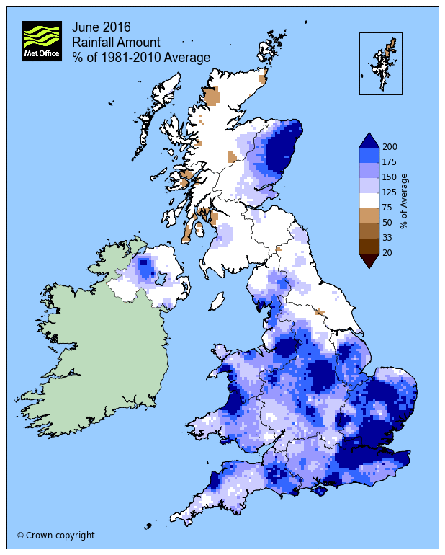
June 2016 Rainfall Anomaly

Slide 4
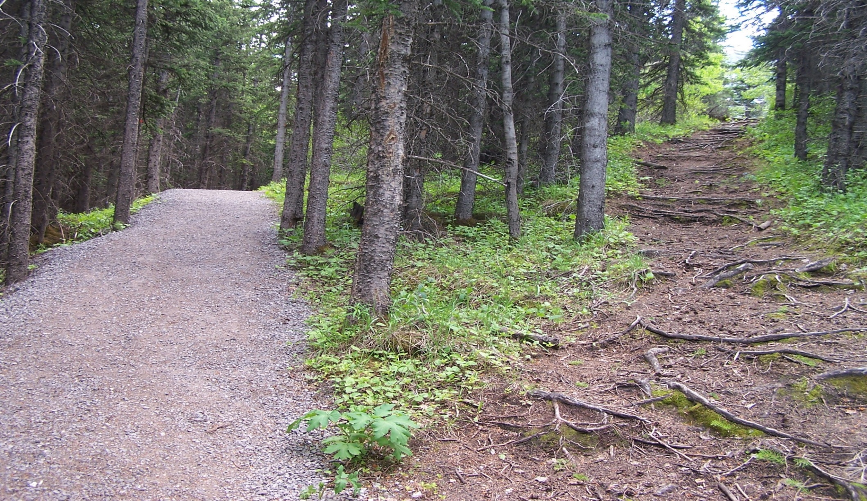
How can resilient urban flood risk management best be achieved?
Continue on our current path
A different urban flood risk future
Image: http://www.conferencesthatwork.com/wp-content/uploads/2013/07/fork-in-the-road-624151138_f1ff60b2db_o.jpg

Slide 5
How can resilient urban flood risk management best be achieved?
“In a nutshell, flood resilience is about adaptive planning.
In an uncertain future, how can we build our roads, parks, buildings, and other urban structures to best manage a wide range of possible circumstances?”
Cooperative Research Centre for Water Sensitive Cities
https://goo.gl/IVTyAl

Slide 6
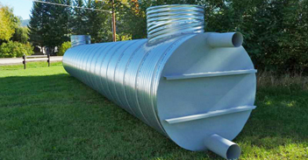
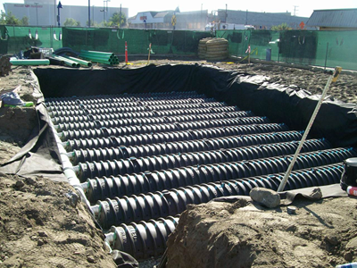
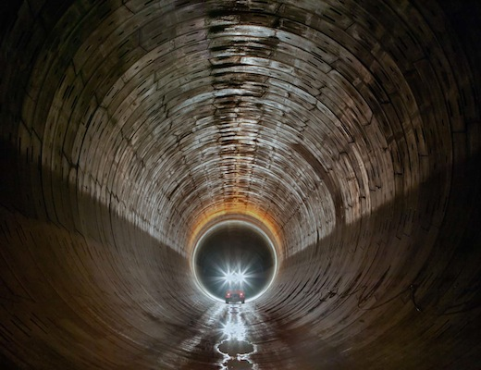
A Grey Future: bigger pipes, more pipes, huge pipes
Images: www.nwl.co.uk

Slide 7
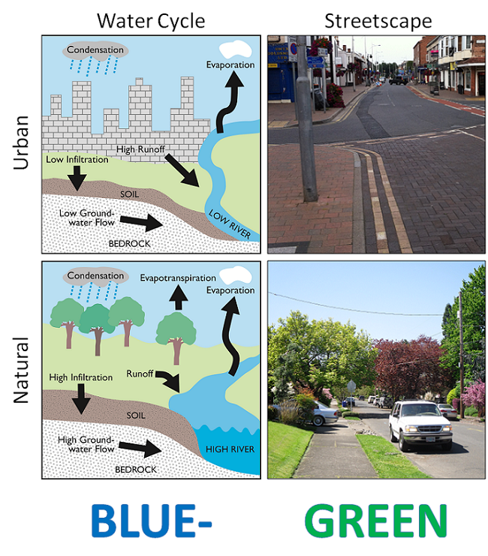
A Blue-Green Future
Working with nature to manage water and deliver a range of other benefits to society, the economy and the environment
Multifunctional landscape
Blue-Green space connectivity

Slide 8
Blue-Green infrastructure can have a significant impact on local surface water flood risk but it is very challenging to significantly impact on low probability high consequence floods at river catchment scale using such techniques.
= Blue-Green + Grey

Slide 9
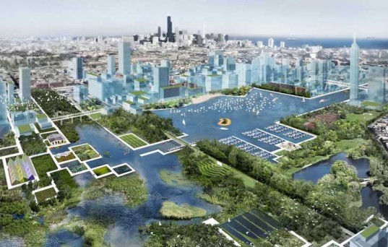
Resilient Blue-Green Cities
Image: https://www.contradodigital.com/wp-content/uploads/2014/06/Blue-Green-City.jpg

Slide 10
Resilient Blue-Green Cities
Blue-Green + Grey = multiple benefits
Day-to-day accrual of non-flood benefits
Multi-functional infrastructure to meet strategic objectives of different departments/organisations
Healthier, happier and resilient communities
Extend lifetime of existing grey assets
Increases breadth of stakeholders involved

Slide 11
Urban Flood Resilience in an Uncertain Future
EPSRC research project (2016-2019)
Aim: make urban flood resilience achievable nationally, by making transformative change possible through adoption of the whole systems approach to urban flood and water management

Slide 12
Urban Flood Resilience
A city’s capacity to maintain future flood risk at acceptable levels by:
preventing deaths and injuries,
minimising damage and disruption during floods,
recovering quickly afterwards,
ensuring social equity,
protecting the city’s cultural identity and economic vitality

Slide 13
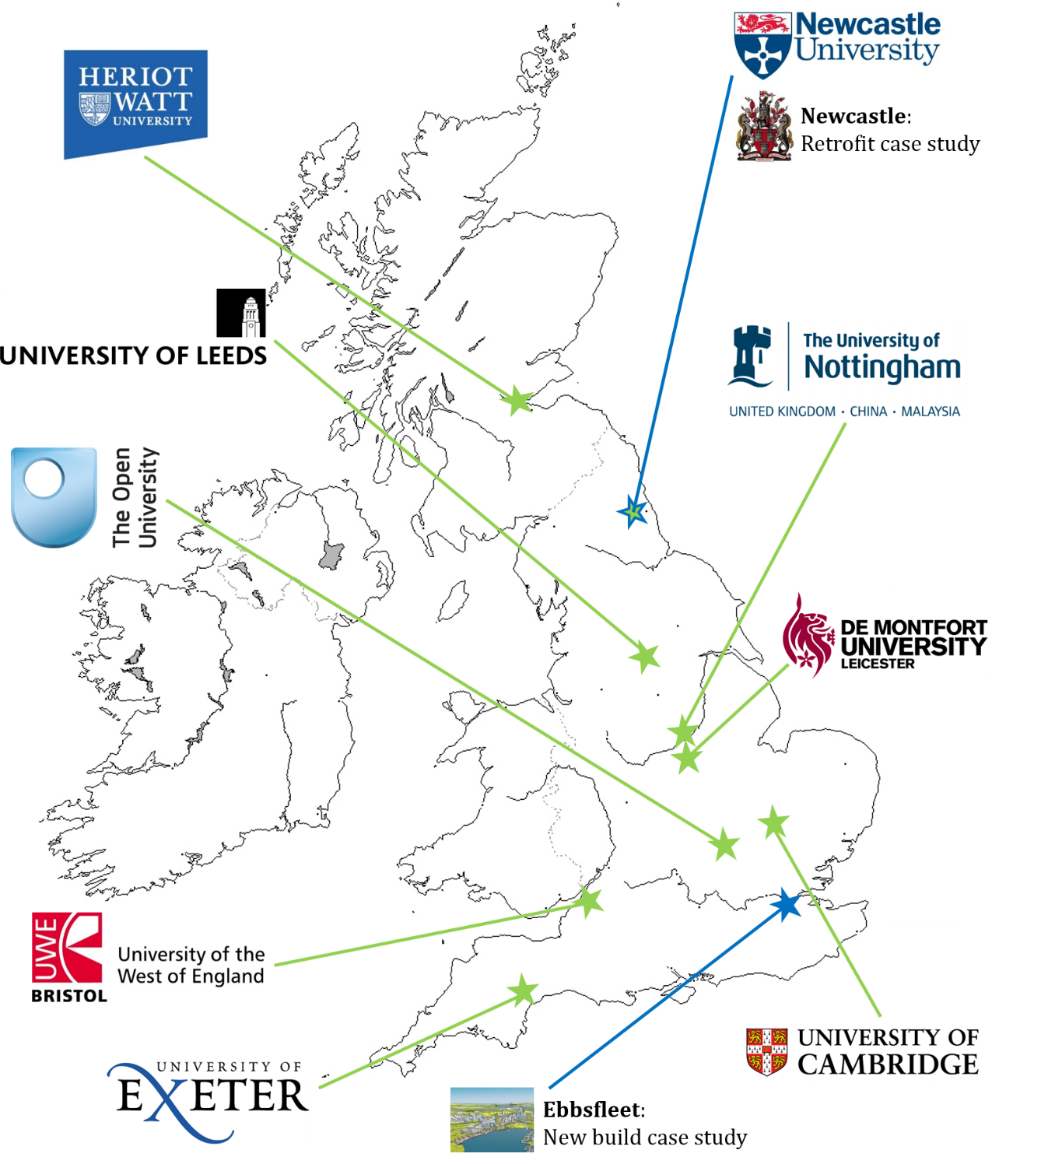
UK Urban Flood Resilience Research Consortium

Slide 14
Urban Flood Resilience Research Themes
Engineering Design of integrated Blue/Green and Grey (B/G+G) surface water treatment trains that support resilient management of both water quantity and quality
Planning that puts urban flood risk management at the heart of urban planning & focuses on interfaces between planners, developers, engineers and communities
Development of flood and water management assets that function inter-operably with other urban systems: transport, energy, land-use and natural systems

Slide 16
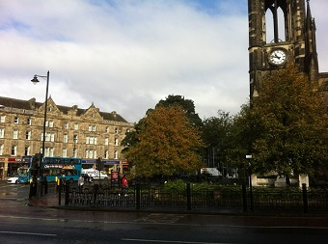
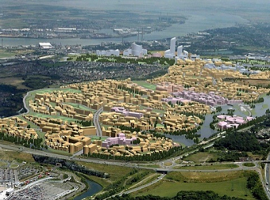
WP5. Achieving urban flood and water resilience in practice
Newcastle
Ebbsfleet
Retrofit and urban renewal
New build in a ‘garden city’

Slide 17
Learning and Action Alliances to facilitate stakeholder collaboration for urban resilience
Flood and water management governance may be enhanced through partnership working, intra- and cross-organisational collaborations, and wide stakeholder participation
Barriers associated with ineffective communication, fragmented responsibilities and ‘siloed thinking’ restrict open dialogue and discussion
Targeted action and innovative solutions
LAA framework
Effective engagement
Social learning

Slide 18
Impact and Feedback
Achievements of the Newcastle LAA (so far…)
Blue-Green Vision (March 2017)
The Vision is for Newcastle to become a city that follows the principles of a Blue-Green City by maximising the opportunities to achieve multiple benefits of Blue-Green approaches to surface water management.
By forming a Learning and Action Alliance (LAA), our overarching goal is to promote this vision and to realise it by recognising, and utilising, windows of opportunity for potentially influencing the strategies of decision makers.

Slide 19
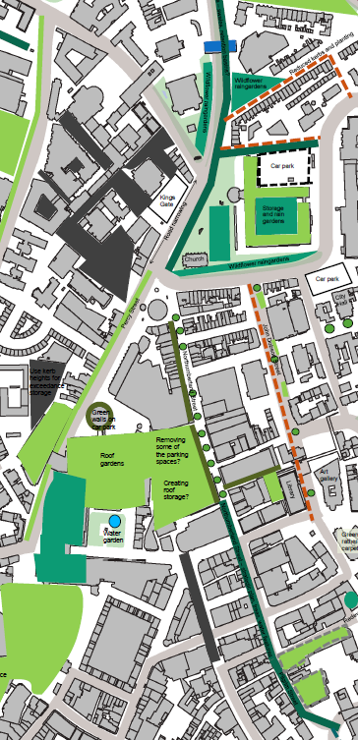
Northumberland Street and John Dobson Street:
Green roofs
Swales (2x2 m) Street trees
Permeable paving

Slide 20
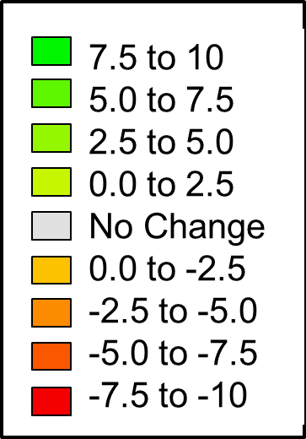
Northumberland Street and John Dobson Street

Slide 21
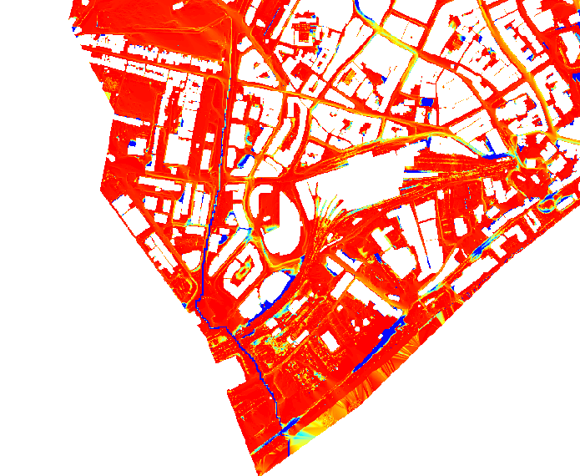
Modelling novel Blue-Green solutions
St James’ Boulevard swale
RP= 50 years, 60 mins
Dimensions of swale:
Width = 2m
Depth < 1m

Slide 22
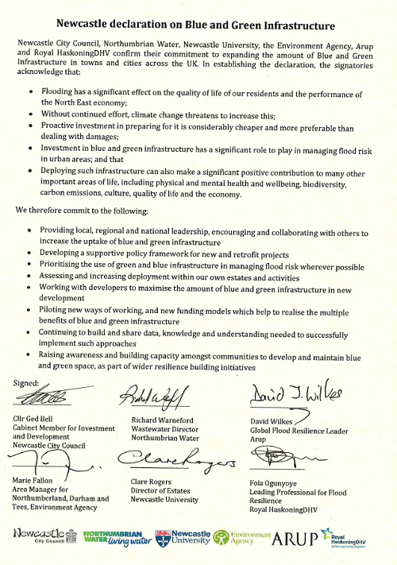
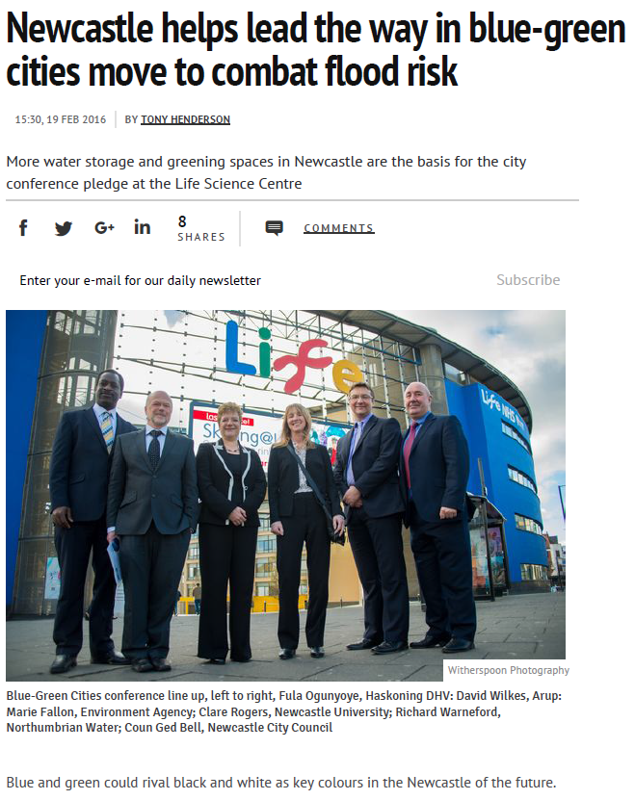
Achievements of the Newcastle LAA (so far…)
Source: http://www.chroniclelive.co.uk/news/north-east-news/newcastle-helps-lead-way-blue-10914312

Slide 23
Acknowledgement
The research presented in this presentation is being conducted as part of the Urban Flood Resilience Research Consortium with supported from:
www.urbanfloodresilience.ac.uk
Urban Flood Resilience @BlueGreenCities

