Slide 1
Perceptions, Challenges and Opportunities around SuDS in Ebbsfleet
Achieving Urban Flood Resilience in an Uncertain Future
Leon Kapetas and Dick Fenner
University of Cambridge
www.urbanfloodresilience.ac.uk Urban Flood Resilience @BlueGreenCities

Slide 2
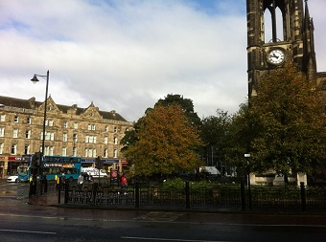
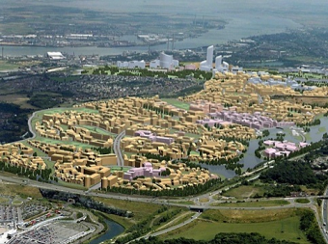
Case Study Cities
Newcastle
Ebbsfleet
Retrofit and urban renewal
Urban regeneration in a ‘garden city’
www.urbanfloodresilience.ac.uk Urban Flood Resilience @BlueGreenCities

Slide 3
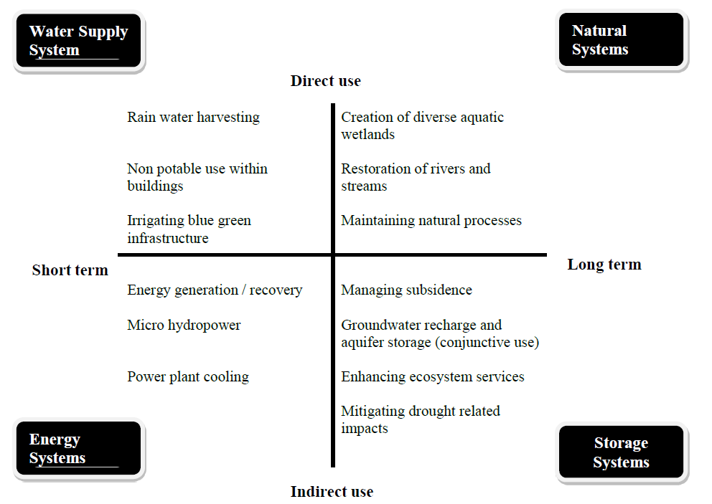
Surface water as a resource in Ebbsfleet
www.urbanfloodresilience.ac.uk Urban Flood Resilience @BlueGreenCities

Slide 4
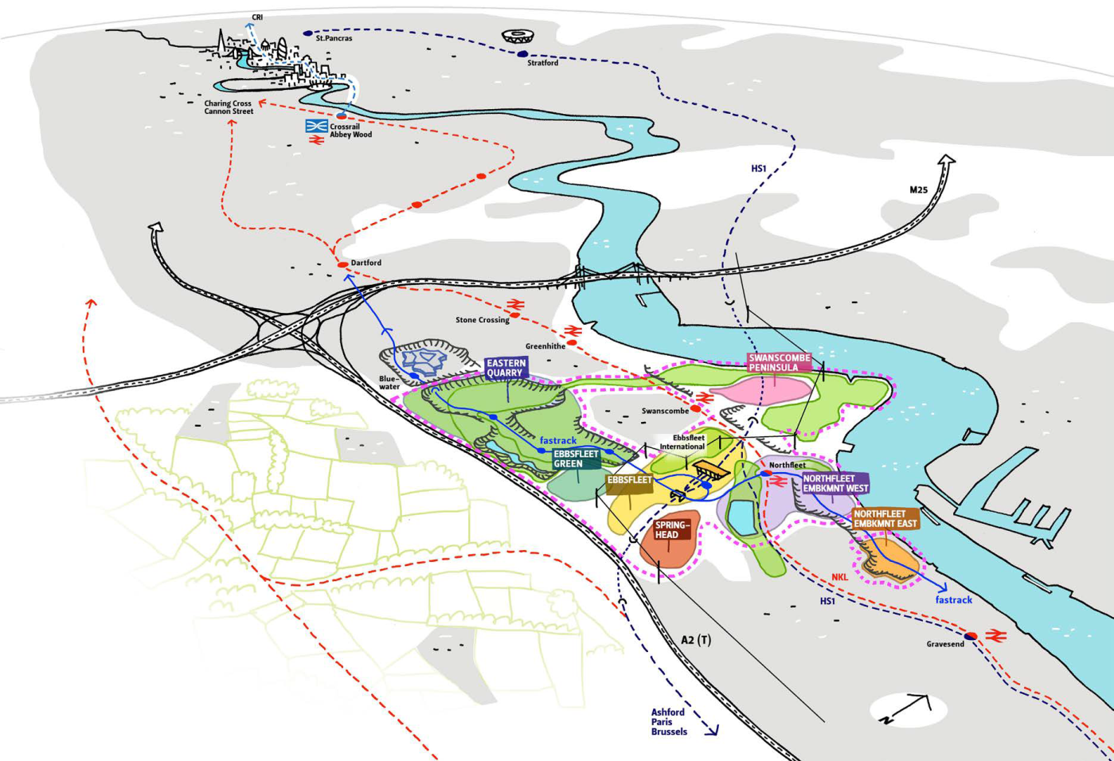
Interviews
Paul Kent, Southern Water
Peter Nelson, Henley Camland
Bronwyn Buntine, KCC
Dave Brown, South East Rivers Trust
Simon Harrison, EDC
www.urbanfloodresilience.ac.uk Urban Flood Resilience @BlueGreenCities

Slide 5
Responsibilities
33% of Water Supply and almost 100% of drainage falls within Southern Water
i.e. no overlap of jurisdiction areas
Kent County Council is the lead local flood authority
Responsible for ordinary water courses
Reasonable solutions addressing “the right to connect”
South East Rivers Trust is 1/50 Trusts responsible for 16 restoration projects
Ebbsfleet Development Corporation, planning authority set up by the government to speed up the delivery of up to 15,000 homes creating a 21st century Garden City.
Developers, mixed ownership and contractor responsibilities in Ebbsfleet
www.urbanfloodresilience.ac.uk Urban Flood Resilience @BlueGreenCities

Slide 6
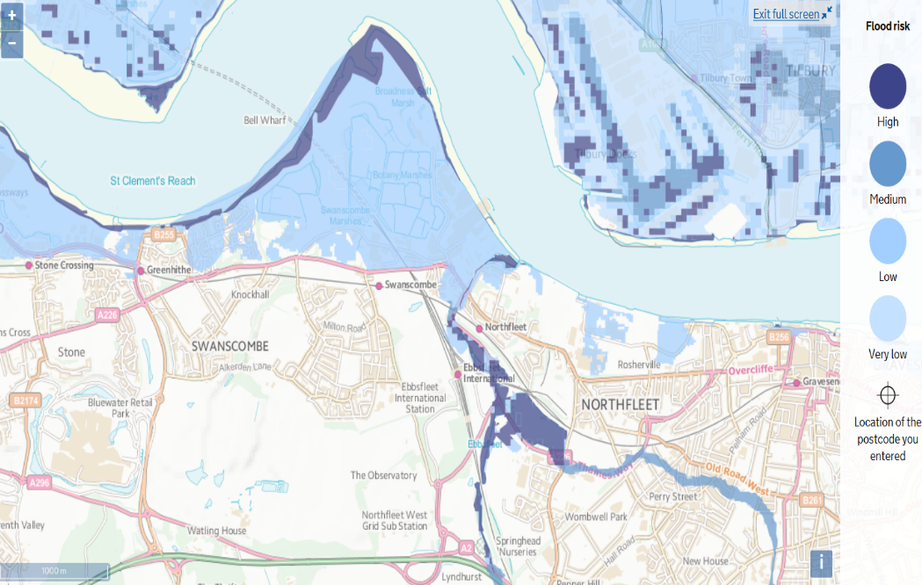
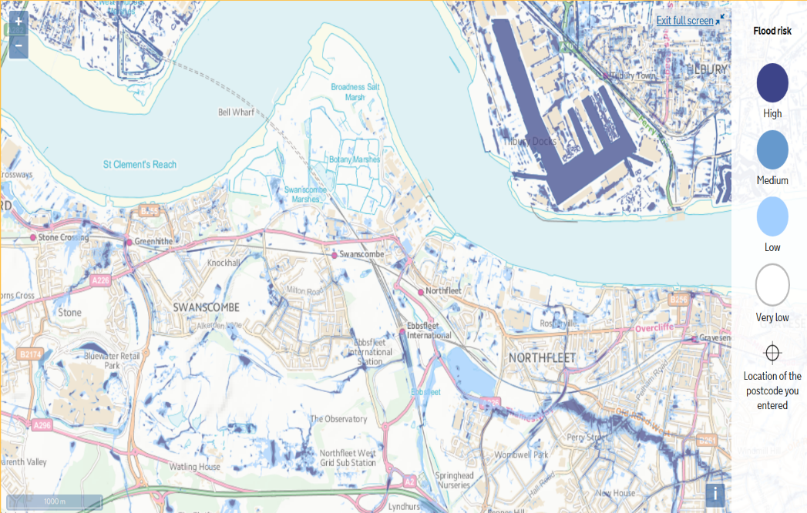
Perceptions on Flood Risk
Of our own make (two balancing lakes)
Continuous need for pumping 100-240 L/s pumping
No risk from river flooding (apart from Peninsula) or surface flooding
www.urbanfloodresilience.ac.uk Urban Flood Resilience @BlueGreenCities

Slide 7
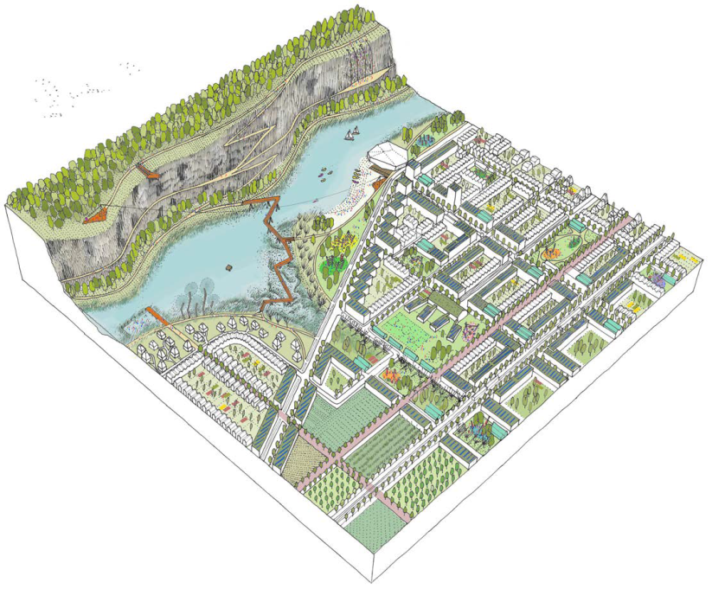
Challenges
Wastewater drainage: planned sewer network and treatment plants will serve commercial and residential activities: no provision for the theme park.
Options:
Maximize (double) existing capacity (cater for 50,000 people)
Transfer flows to another plant
Build new treatment plant in the peninsula
Recognising Ebbsfleet as a good place to live.
Developing an identity of Ebbsfleet
Reduce Flood Risk
- Deal with combined systems and retrofits
- Deal with growth
Improve SUDS delivery by developers (Water. People. Places)
SuDS cost, maintenance and adoption
Better integration between water and landscape engineers
Many water companies operating: uncoordinated extractions and discharges
Securing funding after Brexit
www.urbanfloodresilience.ac.uk Urban Flood Resilience @BlueGreenCities

Slide 8
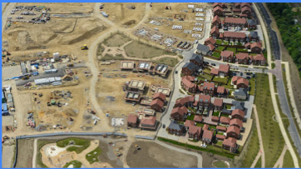
Uncertainties
Population growth: once development is completed there will be more certainty
Climate change: does the 20% rule guarantee flood protection during extreme summer events? Is BG a good option in this context?
Parking area in Ebbsfleet and commercial sites
Traffic management around the development area
www.urbanfloodresilience.ac.uk Urban Flood Resilience @BlueGreenCities

Slide 9
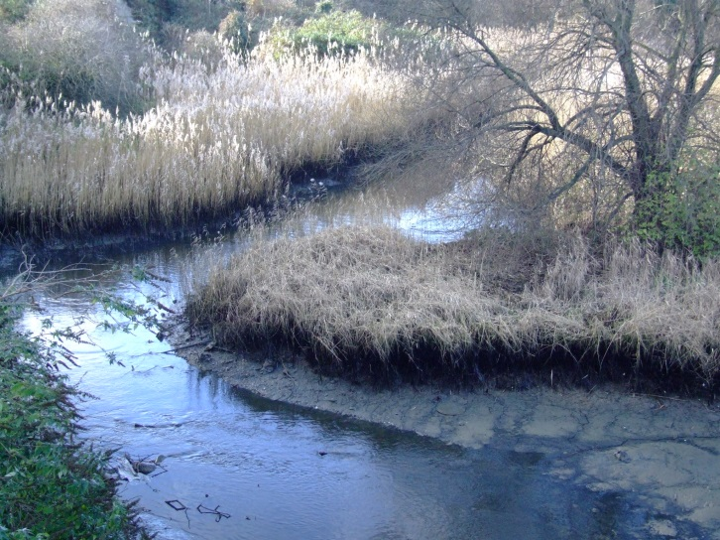
River Ebbsfleet
Chalk river
Source depleted
Significant cost to restore
Funding mostly available for WFD bodies
BG solution for overland flow towards Ebbsfleet River (Cressfield – Station South)
www.urbanfloodresilience.ac.uk Urban Flood Resilience @BlueGreenCities

Slide 10
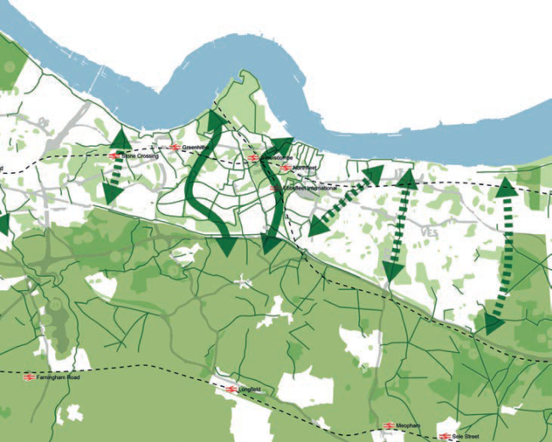
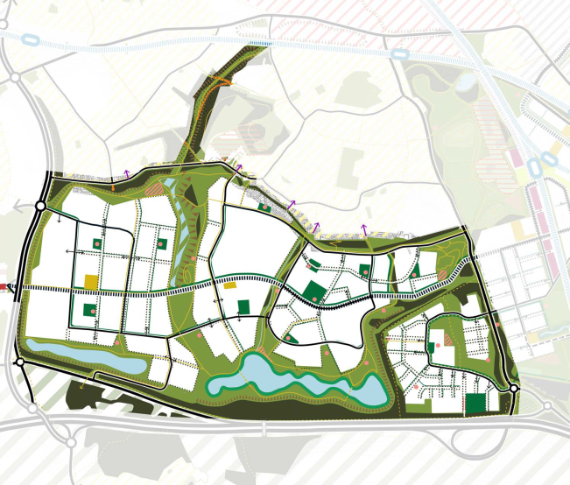
BG Vision
Discover opportunities
BG solution for overland flow towards Ebbsfleet River (Cressfield – Station South)
Quality/quantity control in Northfleet
No major infrastructure on Medway so need to think of NFM, but not clear how to manage NFM: small intervention will have minimal impact on the large scale, desynchronization of streams
Understand the link between the urban and rural scale (e.g. Edenbridge and Tonbridge flooding events).
Swales
Balancing lakes
Design for exceedance
Up to the developers to integrate BG
Groundwater quality/quantity issues in Ebbsfleet limit opportunities
Integrated surface management and planning ahead rather than multiple small interventions
www.urbanfloodresilience.ac.uk Urban Flood Resilience @BlueGreenCities

Slide 11
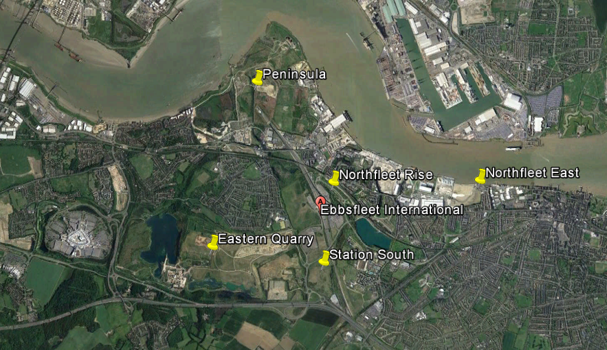
BG Vision
Vision
Healthy Environments.
KPI6: Net gain in accessible open space, public realm and recreation areas completed.
Resilient and Sustainable Systems
KPI9: Number of homes completed which meet enhanced standards for environmental performance, space and accessibility above the statutory minimum.
KPI10: Net improvements to air quality and sustainable urban drainage
www.urbanfloodresilience.ac.uk Urban Flood Resilience @BlueGreenCities

Slide 12
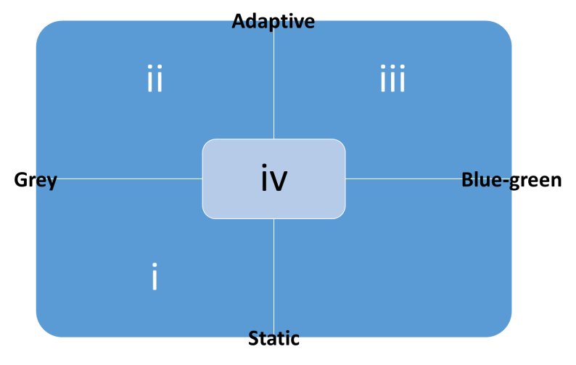
Adaptive Management Framework
– design for uncertainty
current
Not viable under future scenario
static grey: single prediction /single intervention
adaptive grey (limited by inflexibility of grey infrastructure)
adaptive blue-green
adaptive blue green/grey (B/G+G)
Time - years
www.urbanfloodresilience.ac.uk Urban Flood Resilience @BlueGreenCities

Slide 13
Summary
No obvious flooding problems, but need to make sure we are flood-proof in the future too (… climate change, creating impermeable areas)
What are the possibilities for BG interventions in Ebbsfleet?
What are the benefits they deliver?
What is the associated cost and who will fund them? What is the opportunity (Grey) cost?
Who is going to manage/adopt the asset?
How does uncertainty around climate change, policy/economy, development in the area (car park, theme park) influence the adoption of BG solutions?
www.urbanfloodresilience.ac.uk Urban Flood Resilience @BlueGreenCities

Slide 14
Thank you
lk411@cam.ac.uk
www.urbanfloodresilience.ac.uk Urban Flood Resilience @BlueGreenCities

