Slide 1
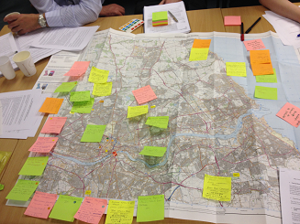
Learning and Action Alliances
www.urbanfloodresilience.ac.uk Urban Flood Resilience @BlueGreenCities

Slide 2
Introducing Learning and Action Alliances
Flood and water management governance may be enhanced through partnership working, intra- and cross-organisational collaborations, and wide stakeholder participation
Barriers associated with ineffective communication, fragmented responsibilities and ‘siloed thinking’ restrict open dialogue and discussion
Targeted action and innovative solutions
LAA framework
Effective engagement
Social learning

Slide 3
Barriers to Blue-Green infrastructure
Socio-political
Legislation, regulations
Adoption of assets
Lack of knowledge
Ineffective communi-cation
‘Novelty’
Issues with partnership working
Funding and costs
Culture, public perception
Identifying multiple benefits
Competing priorities

Slide 4
Learning and Action Alliances (LAAs)
A LAA is usually an open arrangement where participants create a joint understanding of a problem and its possible solutions based on rational criticism and coherence through discussion
It facilitates the identification of innovative ideas for the solution of complex (wicked) problems outside the constraints of existing formal institutional settings
Solutions or ideas are afterwards presented in formal inter-organisational decision-making processes

Slide 5
Learning and Action Alliances (LAAs)
No fixed structure in a LAA
Founded on their own specific vision that evolves over their lifetime
Champions are key
Aim: to break down barriers to both horizontal and vertical information sharing

Slide 6
Benefits of joining LAAs
Networking:
Opening and broadening communication channels
Strengthening existing relationships
Co-production of knowledge and learning from discussions (possibly outside professional remit)
Opportunities for collaborative working for common goals
Identification of joint funding schemes
Realisation of common goals and objectives of many organisations
Speeding up data sharing between partners
Access (and influence) to academic research

Slide 7
Can LAAs work?
Don Catchment (Rotherham and Sheffield)
Newcastle
Tewksbury
Bergen
Hannover
Hamburg
Taiwan
Yorkshire and Humber - became part of the formal process for delivering regional flood risk management
Dordrecht - significantly influenced development of local urban masterplans

Slide 8
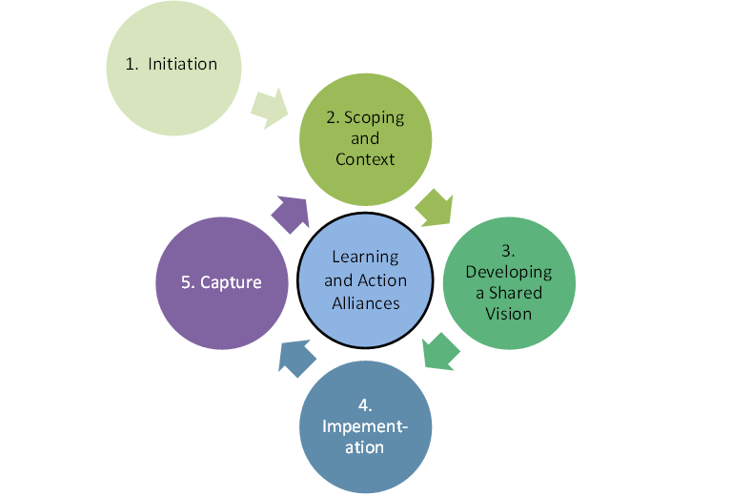
Establishing and running LAAs
Identifying/acting upon 'quick-wins‘
Formulating initiatives to respond to and deliver the vision
Adapted from Ashley et al., (2012)

Slide 9
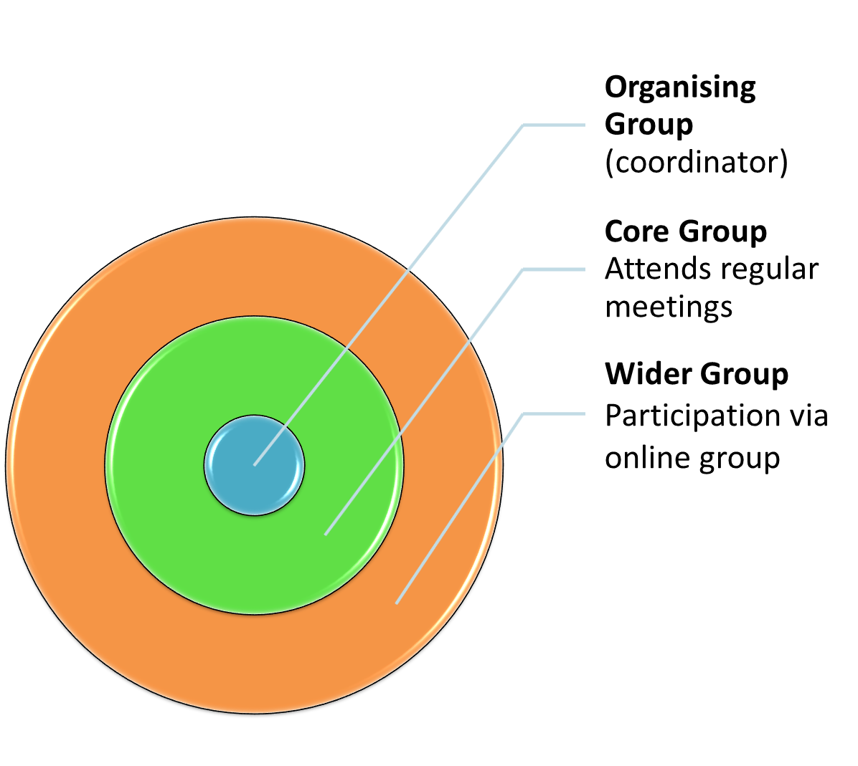
LAA membership
Express your interest in joining by competing form

Slide 10
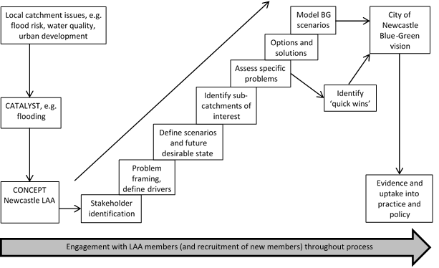
Developing a shared vision
Ebbsfleet (Blue-Green) Vision
flood, drought
Learning and Action Alliance

Slide 11
Impact and Feedback
Achievements of the Newcastle LAA
Blue-Green Vision (March 2017)
The Vision is for Newcastle to become a city that follows the principles of a Blue-Green City by maximising the opportunities to achieve multiple benefits of Blue-Green approaches to surface water management.
By forming a Learning and Action Alliance (LAA), our overarching goal is to promote this vision and to realise it by recognising, and utilising, windows of opportunity for potentially influencing the strategies of decision makers.

Slide 12
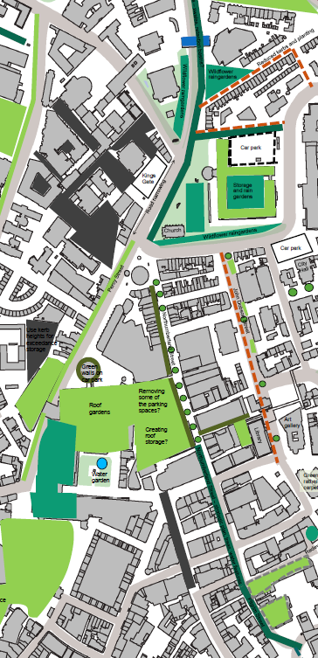
Northumberland Street and John Dobson Street:
Green roofs
Swales (2x2 m) Street trees
Permeable paving

Slide 13
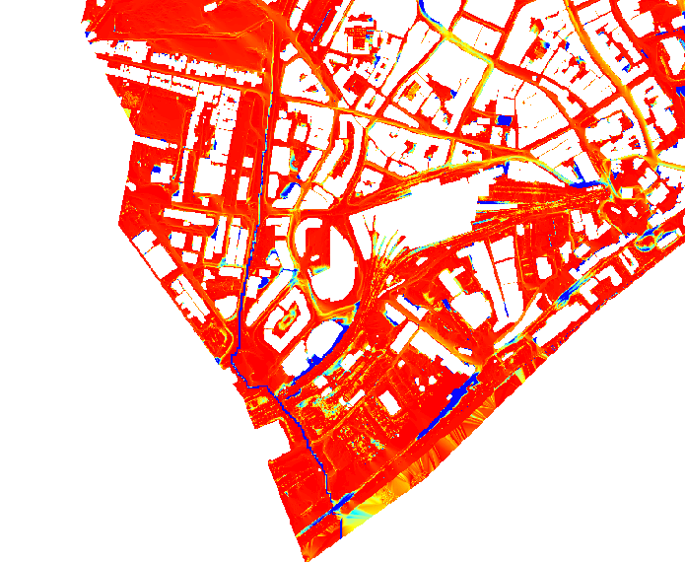
Modelling novel Blue-Green solutions
St James’ Boulevard swale
RP= 50 years, 60 mins
Dimensions of swale:
Width = 2m
Depth < 1m

Slide 14
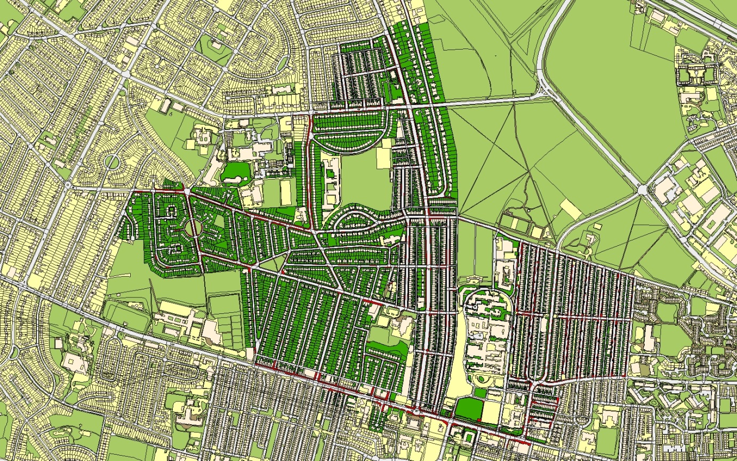
Priority schemes in Wingrove (residential area)

Slide 15
Residents’ perceptions of permeable paving and rain gardens - Wingrove
%
%
I would like to have permeable paving
I understand the role of permeable paving in reducing flood risk
%
%
I would be happy to pull weeds out of the permeable paving
I would be happy to sweep and clear the permeable paving

Slide 16
Residents’ perceptions of permeable paving and rain gardens - Wingrove
LAA members:
gatekeepers for community access
suggesting questions to ask community that would generate information to help meet their objectives
helping research team ensure research outputs will be useful for practitioners

Slide 17
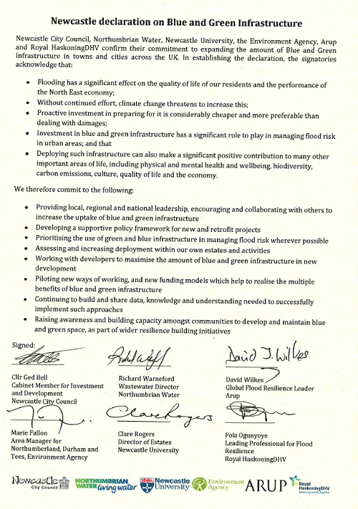
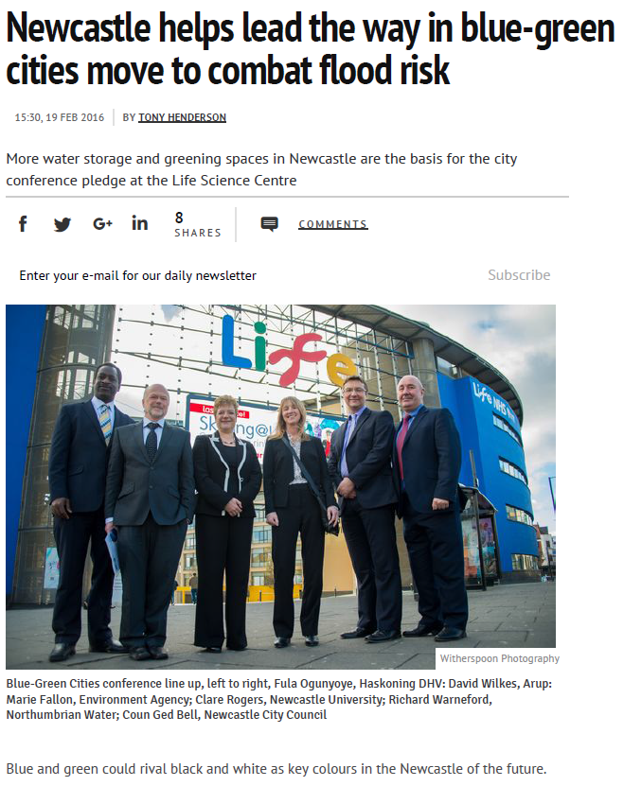
Achievements of the Newcastle LAA
Source: http://www.chroniclelive.co.uk/news/north-east-news/newcastle-helps-lead-way-blue-10914312

Slide 18
Ebbsfleet Learning and Action Alliance
Stakeholder drivers for involvement (to make meetings useful)
Key flood and water management issues (including drought)
Environmental and social issues
Geographical remit of LAA
Other stakeholders that could be involved
Terms of reference (frequency of meetings, roles and responsibilities of members, expectations placed on participation, protocols for group communication and data sharing)
Case study locations within Ebbsfleet Garden City
Ebbsfleet LAA vision and strategic objectives

Slide 19
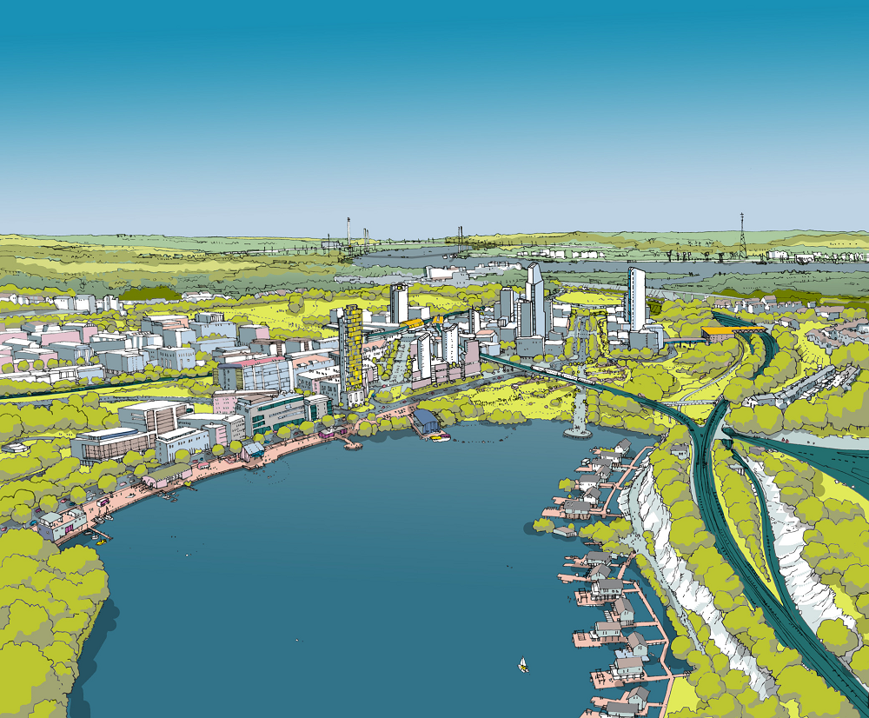
Workshop exercise:
Developing a vision for a resilient, sustainable Ebbsfleet

Slide 20
Workshop exercise: developing a vision for a resilient, sustainable Ebbsfleet
What can the research project do for Ebbsfleet?
Timing of research (prioritising)?
What can the LAA do for Ebbsfleet?
What quick-wins can be achieved?
Who should be involved?
What is the geographical remit of the LAA?
What is the frequency of meetings?

