Slide 1







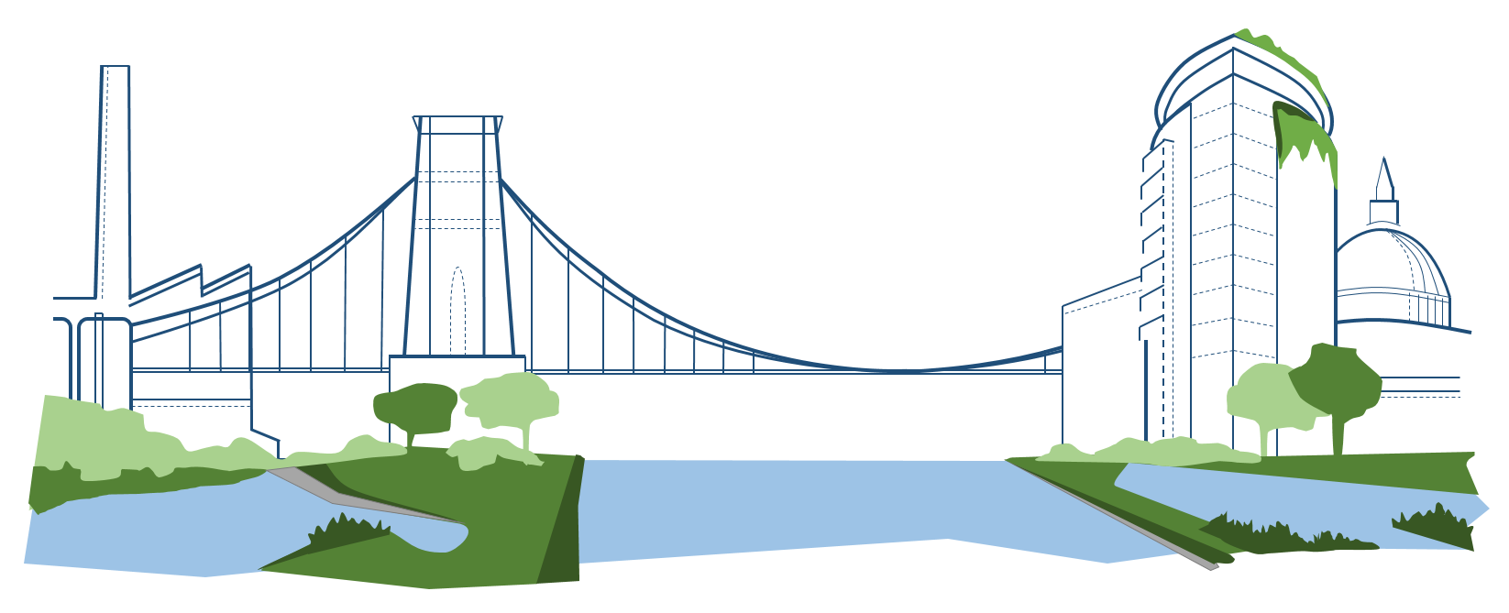

Achieving urban flood resilience through Blue-Green Cities
Dr Emily O’Donnell University of Nottingham 7th December 2016
www.urbanfloodresilience.ac.uk
Urban Flood Resilience @BlueGreenCities

Slide 2
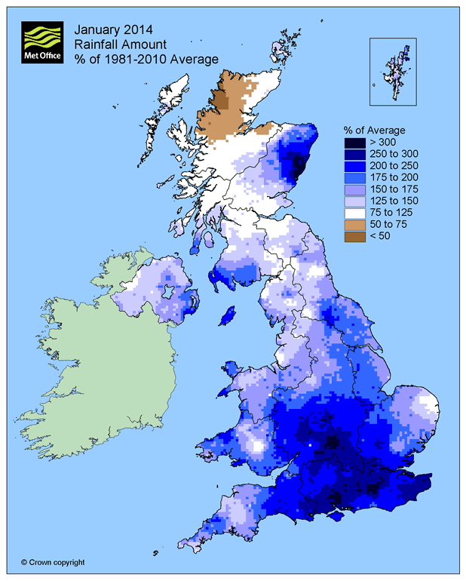
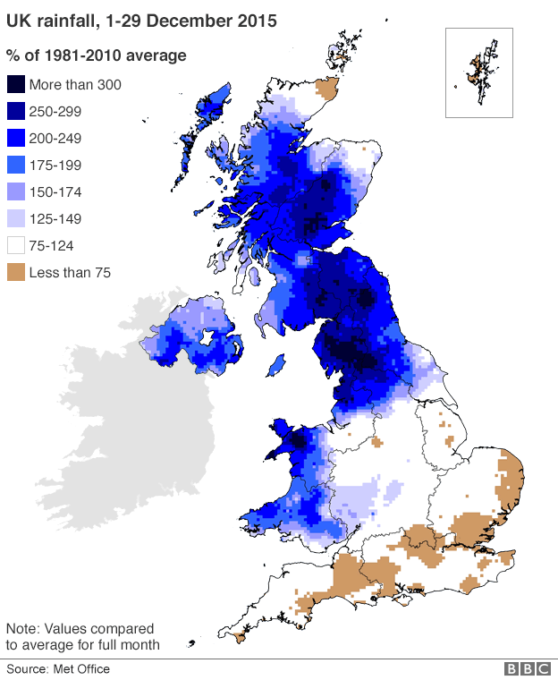
January 2014 Rainfall Anomaly
December 2015 Rainfall Anomaly

Slide 3
December 2015 Rainfall Anomaly

Slide 4
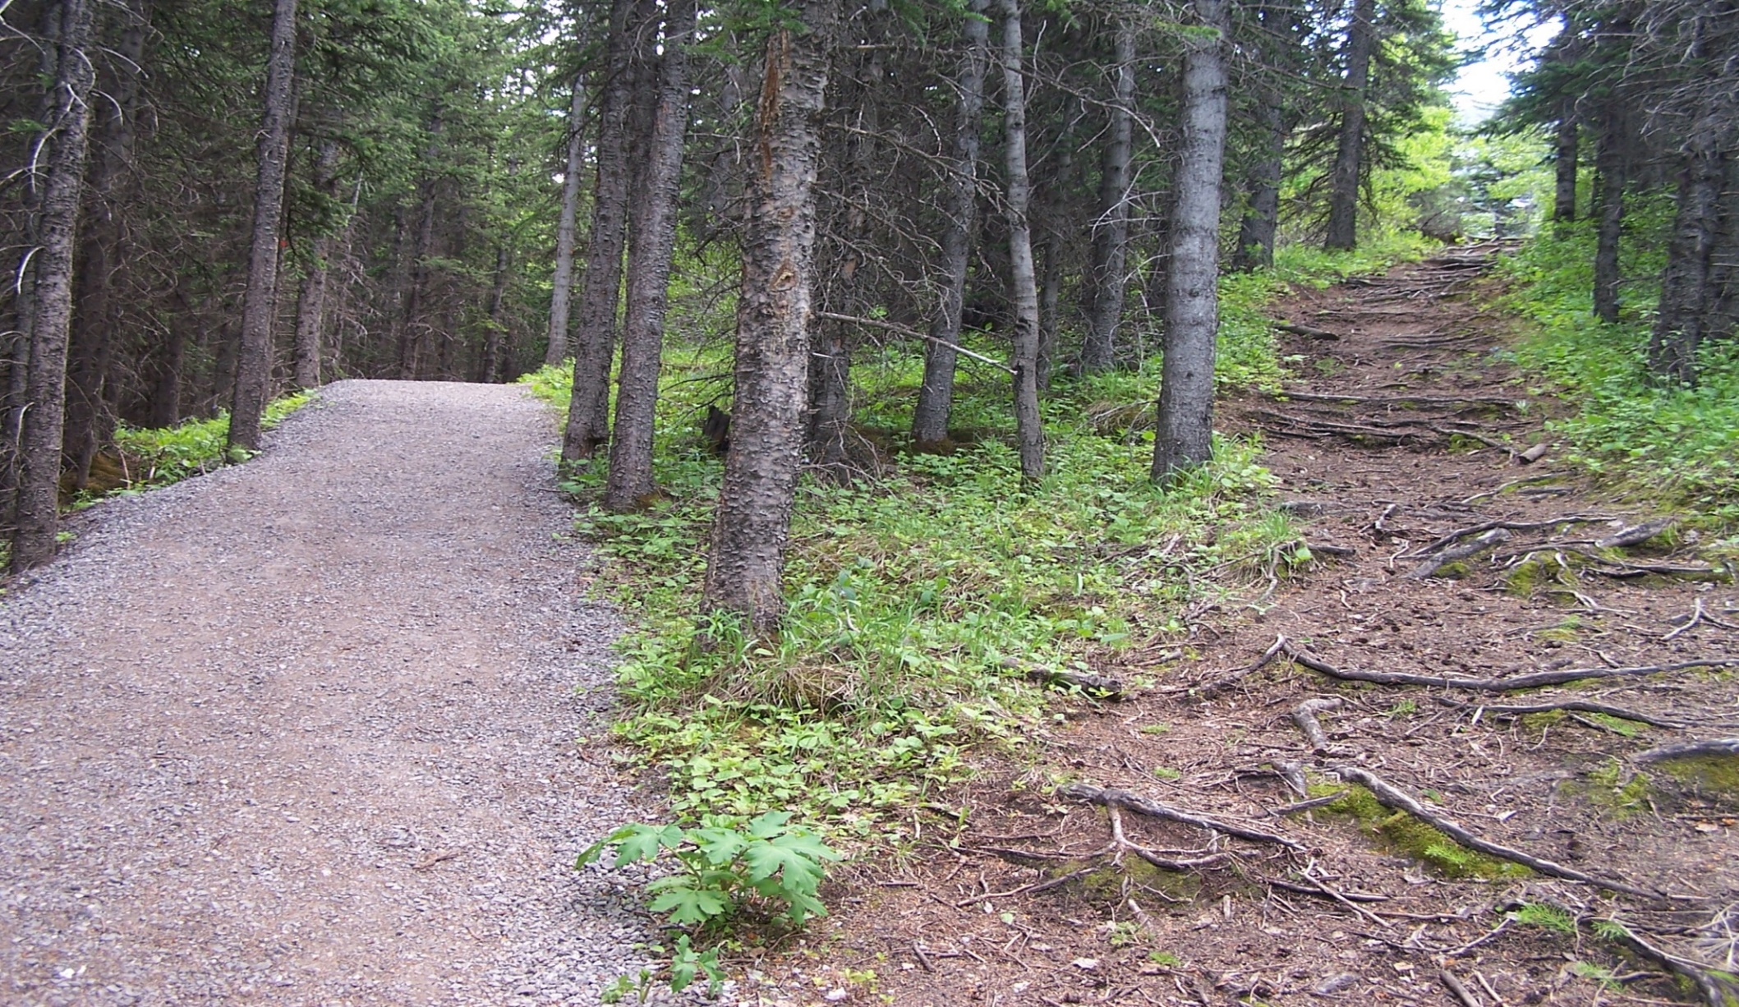
How can resilient urban flood risk management best be achieved?
Continue on our current path
A different urban flood risk future
Image: http://www.conferencesthatwork.com/wp-content/uploads/2013/07/fork-in-the-road-624151138_f1ff60b2db_o.jpg

Slide 5
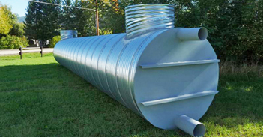
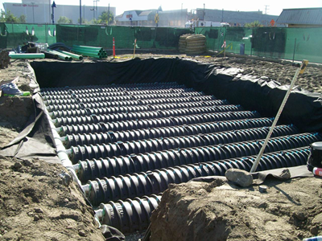
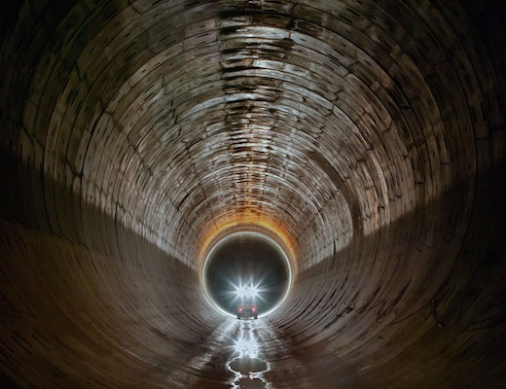
A Grey Future: bigger pipes, more pipes, huge pipes
Images: www.nwl.co.uk

Slide 6
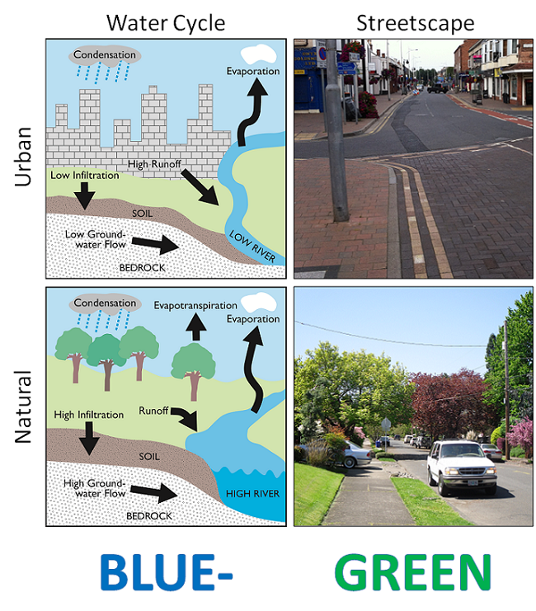
A Blue-Green Future
Working with nature to manage water and deliver a range of other benefits to society, the economy and the environment
Multifunctional landscape
Blue-Green space connectivity

Slide 7
Blue-Green infrastructure can have a significant impact on local surface water flood risk but it is very challenging to significantly impact on low probability high consequence floods at river catchment scale using such techniques.
= Blue-Green + Grey

Slide 8
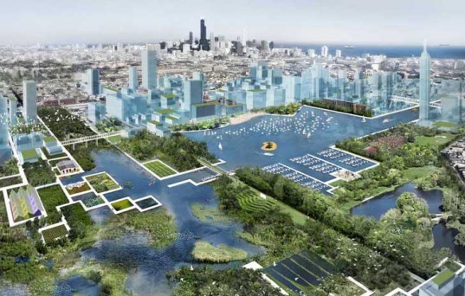
Resilient Blue-Green Cities
Image: https://www.contradodigital.com/wp-content/uploads/2014/06/Blue-Green-City.jpg

Slide 9

Resilient Blue-Green Cities
Blue-Green + Grey = multiple benefits
Day-to-day accrual of non-flood benefits
Multi-functional infrastructure to meet strategic objectives of different departments/organisations
Healthier, happier and resilient communities
Extend lifetime of existing grey assets
Increases breadth of stakeholders involved

Slide 10
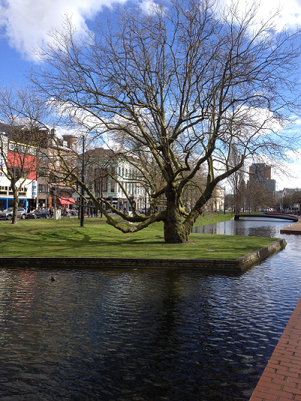
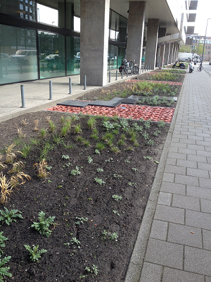
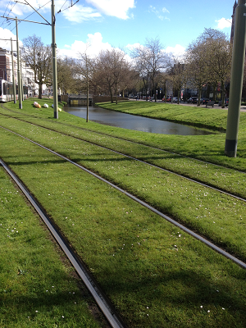
Rotterdam, the Netherlands

Slide 11
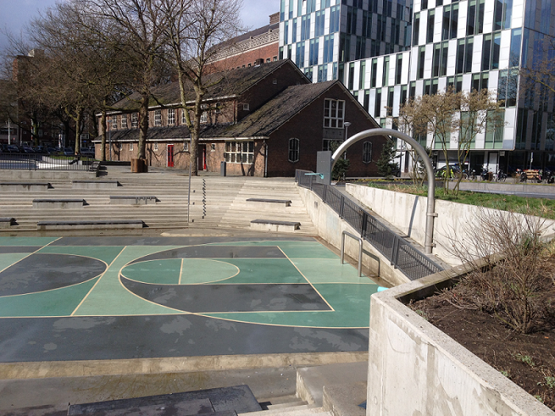
Benthemplein Water Plaza, Rotterdam

Slide 12
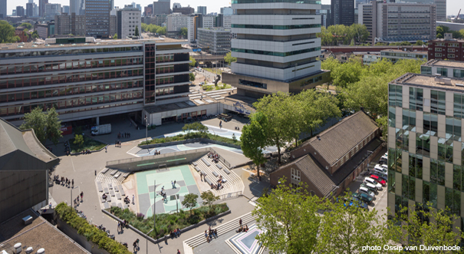
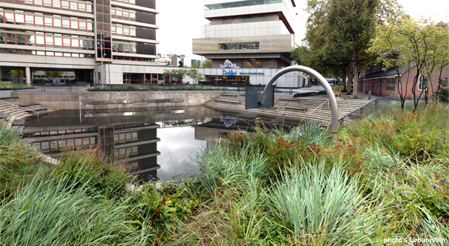
Benthemplein Water Plaza, Rotterdam
Images: http://www.urbanisten.nl/wp/?portfolio=waterplein-benthemplein

Slide 13
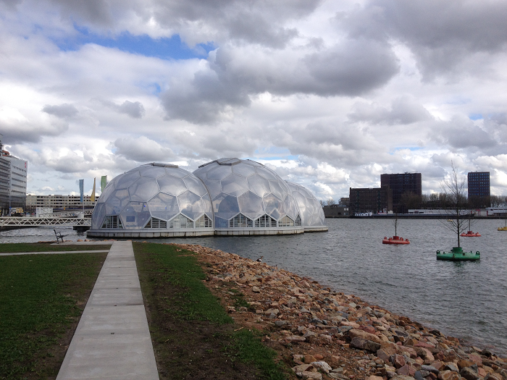
Drijvend Paviljoen (floating pavilion), Rotterdam

Slide 14
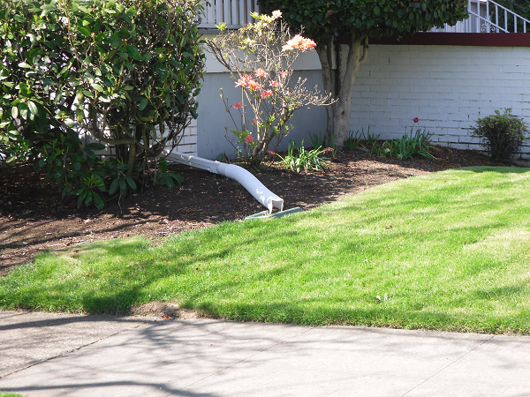
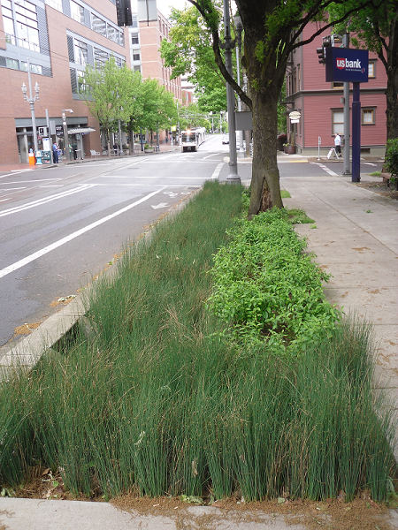
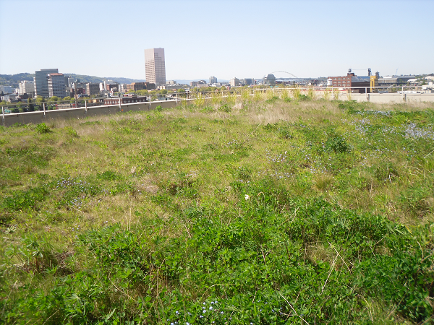
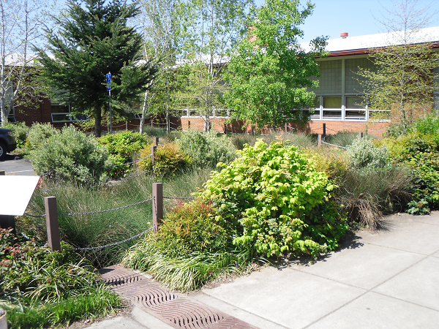
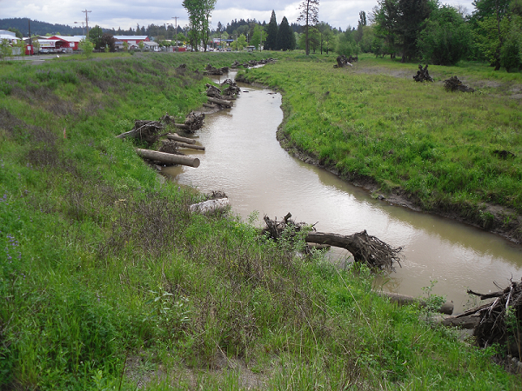
Portland, Oregon (US)

Slide 15
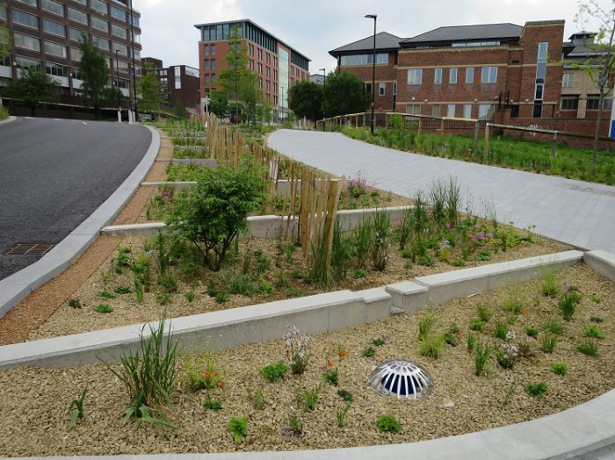
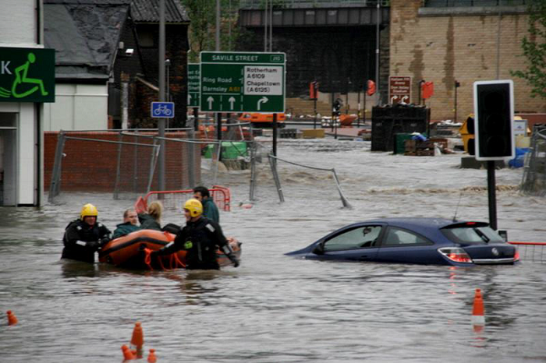
Transformative change to urban flood risk management in Sheffield (NFRR pilot core city)
https://lynncroweblog.wordpress.com/2015/04/29/flood-defence-protection-in-the-lower-don-valley-sheffield/
http://www.biotope-city.net/gallery/designing-ecologically-sensitive-green-infrastructure-serves-people-and-nature

Slide 16
What are the barriers to greater implementation of Blue-Green infrastructure?

Slide 17
Barriers to Blue-Green infrastructure
Socio-political barriers
Legislation, regulations
Adoption of assets
Lack of knowledge
Ineffective communi-cation
‘Novelty’
Issues with partnership working
Funding and costs
Culture, public perception
Identifying multiple benefits
Competing priorities
Thorne et al., 2015, doi:10.1111/jfr3.12218

Slide 18
Overcoming barriers to Blue-Green infrastructure
1
Promote multifunctional space and identify, quantify and monetise the multiple benefits
2
Improve education and communication, raise awareness, community engagement
2
Partnership working from the project outset

Slide 19
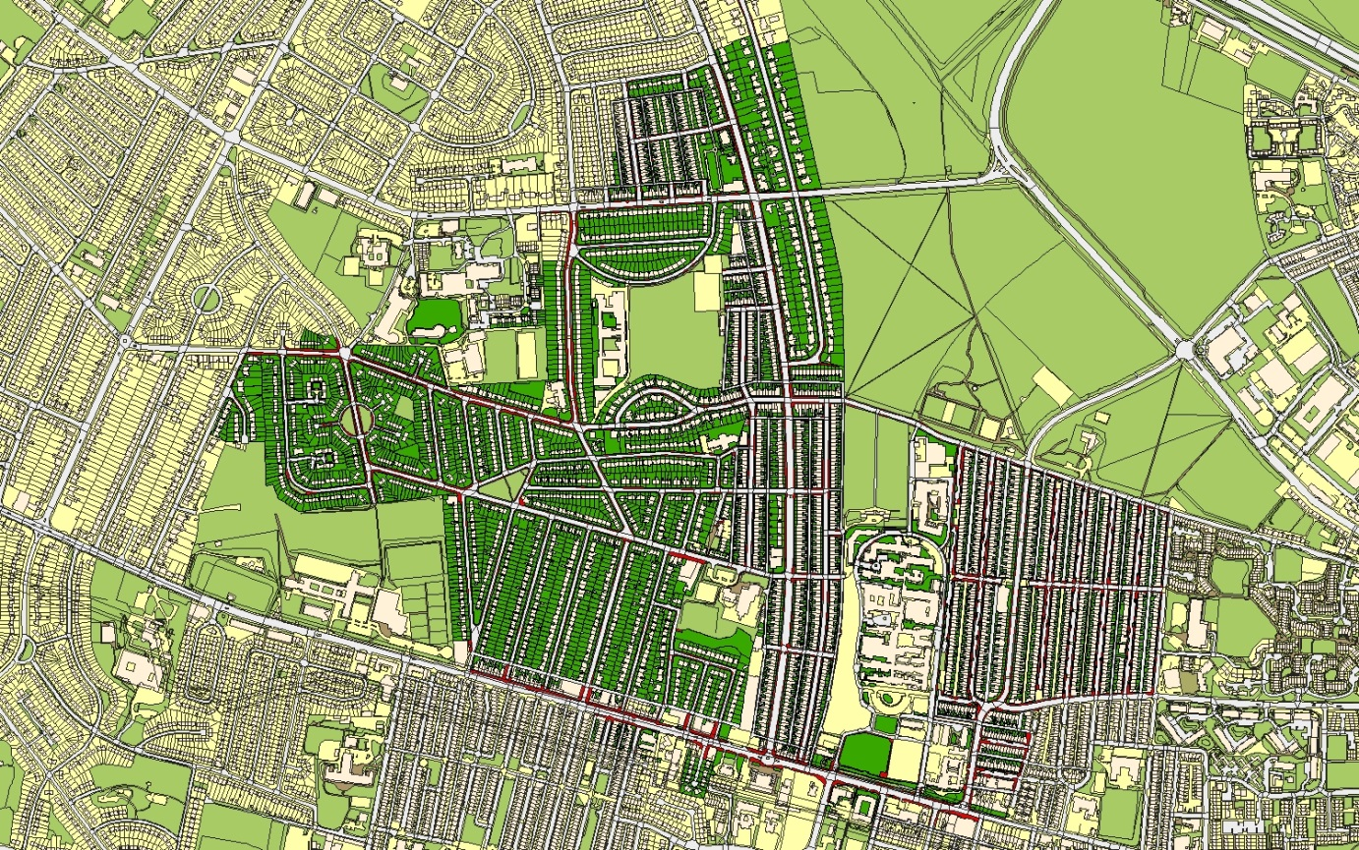
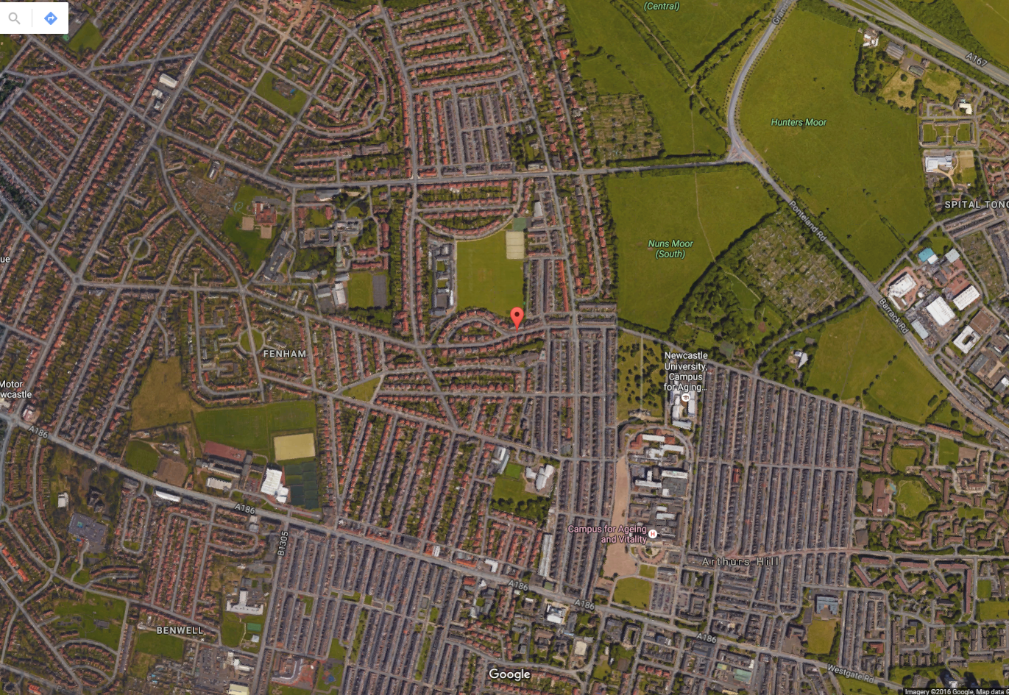
Evaluating the multiple benefits of Blue-Green infrastructure (Newcastle case study)

Slide 20
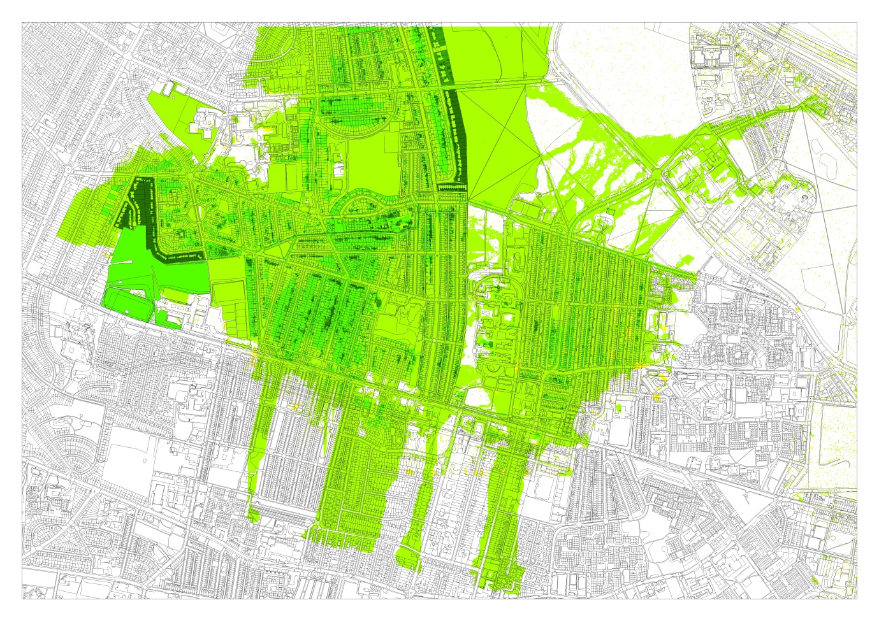
Evaluating the multiple benefits of Blue-Green infrastructure
ArcGIS toolkit for multiple benefit evaluation
Air pollution
Access to greenspace
Carbon sequestration
Noise reduction
Habitat connectivity
Flood damage reduction
(Morgan and Fenner, in review)
Toolbox: free to download: http://www.bluegreencities.ac.uk/bluegreencities/publications/multiple-benefit-toolbox.aspx

Slide 21
Multiple benefits using BeST
Using CIRIA’s Benefits of SuDS Tool (BeST)
Health
Recreation
E. O’Donnell report for Northumbrian Water, August 2016

Slide 22
Overcoming barriers to Blue-Green infrastructure
1
Promote multifunctional space and identify, quantify and monetise the multiple benefits
2
Improve education and communication, raise awareness, community engagement
2
Partnership working from the project outset

Slide 23
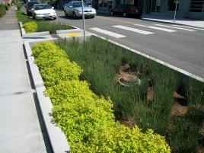
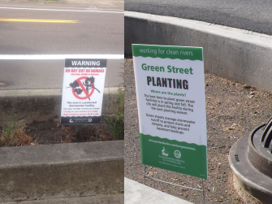
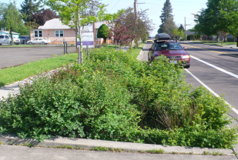
Community behaviours and preferences
Local People are the local experts - with useful knowledge
People value Blue-Green assets - if they understand them
People will help maintain the Blue-Green assets they value
People need to feel ownership to make BG solutions work
People must be engaged prior to and throughout implementation
Everett et al., 2015, doi:10.1111/jfr3.12225

Slide 24
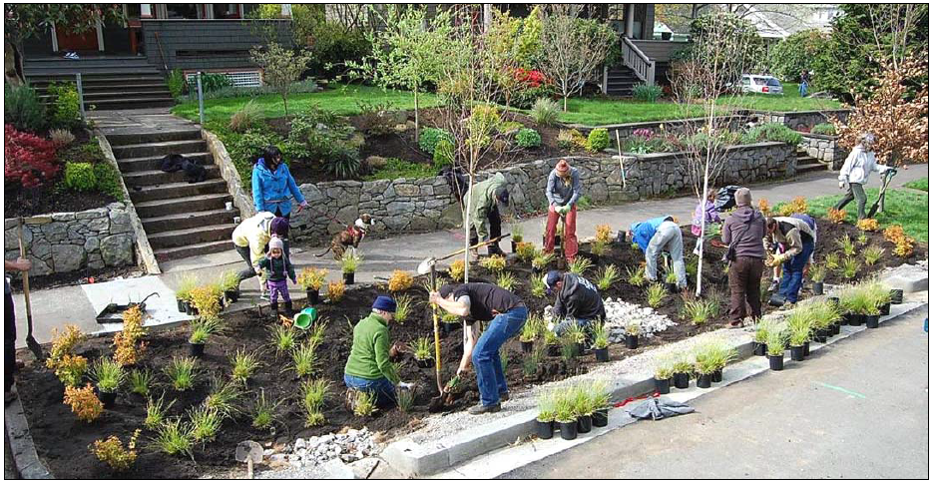
Overcoming barriers
Building confidence and involving the community
Improving public education and access to information, social learning and community engagement, positive experience of asset performance, changing perceptions
Many of the barriers may be difficult to overcome – systemic and embedded within organisational cultures, practices and processes
(Brown and Farrelly, 2007)
Image: Oregon Department of Environmental Quality 2010.

Slide 25
Overcoming barriers to Blue-Green infrastructure
1
Promote multifunctional space and identify, quantify and monetise the multiple benefits
2
Improve education and communication, raise awareness, community engagement
2
Partnership working from the project outset

Slide 26
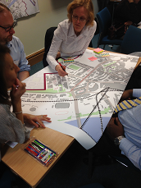
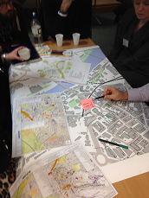
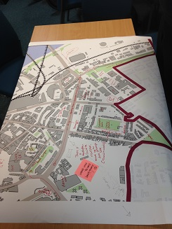
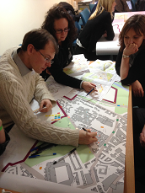
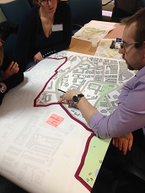
The Newcastle Learning and Action Alliance
‘Blue-Greening’ the urban core – a master-planning workshop

Slide 27
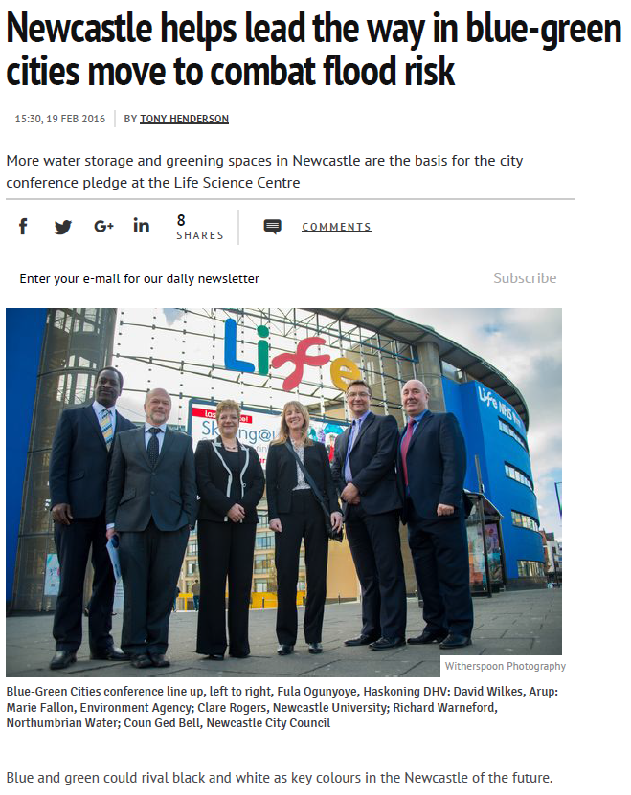
Impact and Feedback
Source: http://www.chroniclelive.co.uk/news/north-east-news/newcastle-helps-lead-way-blue-10914312

Slide 28
Achieving urban flood resilience in an uncertain future
Conduct research necessary to make urban flood resilience achievable nationally, by making transformative change possible through adoption of the whole systems approach to urban flood and water management
www.urbanfloodresilience.ac.uk
Urban Flood Resilience @BlueGreenCities

Slide 29
Achieving urban flood resilience in an uncertain future
Investigate how planning and organisation of existing and new urban water systems (including flood risk management, waste/stormwater management and water security) can be transformed to:
ensure satisfactory service delivery (flood, normal and drought conditions);
enhance and extend the useful lives of ageing grey assets by supplementing and integrating them with multi-functional Blue-Green infrastructure
www.urbanfloodresilience.ac.uk
Urban Flood Resilience @BlueGreenCities

Slide 30
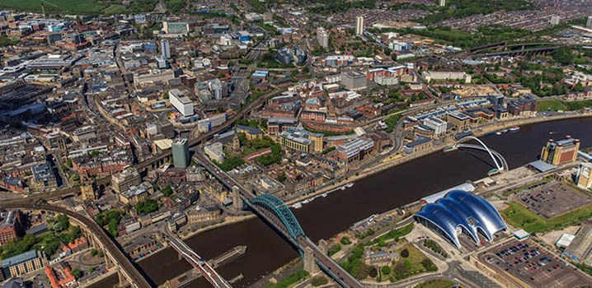
“what is required is a fundamental change in how we view flood management, from flood defence where we protect ourselves to one of resilience, living with and making space for water and the opportunity to get “more from less” by seeing all forms of water as providing multiple benefits.”
Commission of Inquiry into flood resilience of the future titled ‘Living with water’, March 2015. All Party Group for Excellence in the Built Environment, House of Commons, London, p. 32.

Slide 31
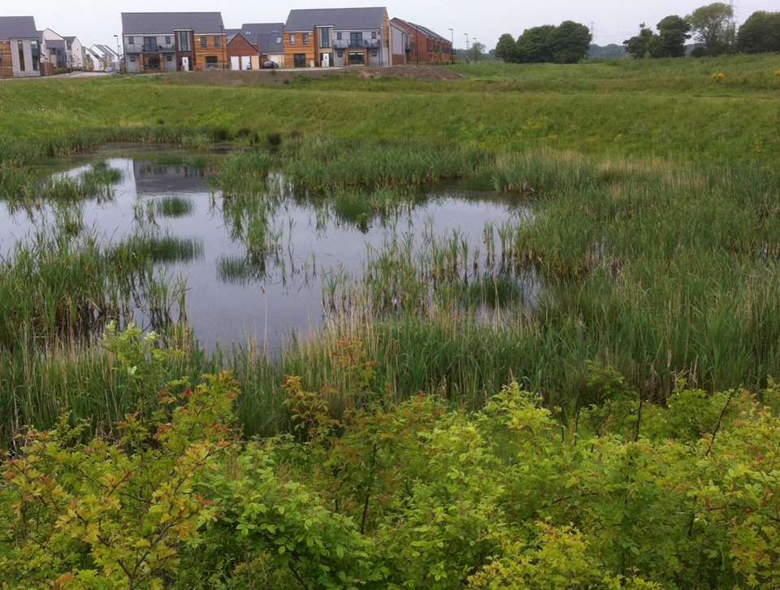
The Blue-Green Cities Research Consortium (2013-2016) was supported by:
Engineering and Physical Sciences Research Council
Northern Ireland Rivers Agency
Environment Agency
Northumbrian Water
Newcastle City Council
The Urban Flood Resilience Research Consortium (2016-2019) is supported by:
Engineering and Physical Sciences Research Council
Environment Agency
Water Industry Forum
UKWIR
Atkins
Ebbsfleet Development Corporation
Newcastle City Council
www.urbanfloodresilience.ac.uk
Urban Flood Resilience @BlueGreenCities

