Slide 1





Managing Urban
Flood Risk
Colin Thorne
University of Nottingham
on behalf of the Blue-Green Cities and Urban Flood Resilience Projects
bluegreencities.ac.uk
EPSRC Grant EP/K013661/1

Slide 2
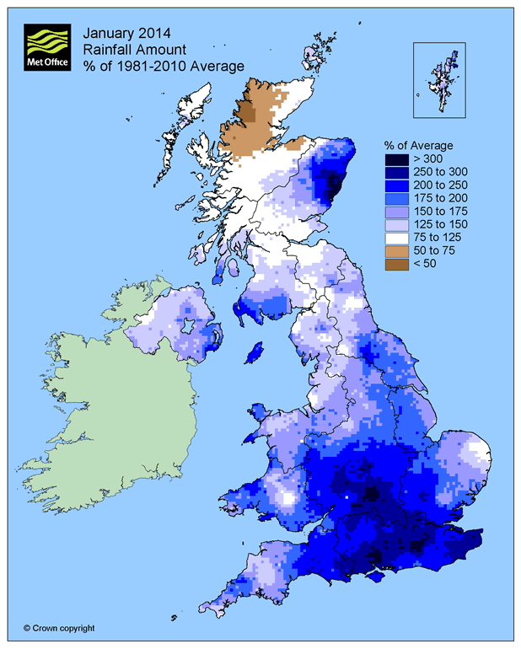
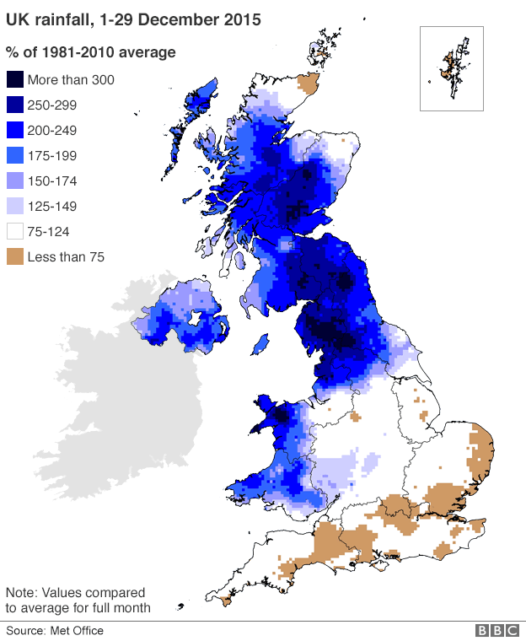
December 2015 Rainfall Anomaly
January 2014 Rainfall Anomaly
Notes:
The Challenge – more frequent rainstorms and super storms (1 slide - 1 minute) and storm surges
Events in 2014 and 2015 demonstrate that ever UK city is at risk of flooding and that flooding cannot be prevented entirely.

Slide 3
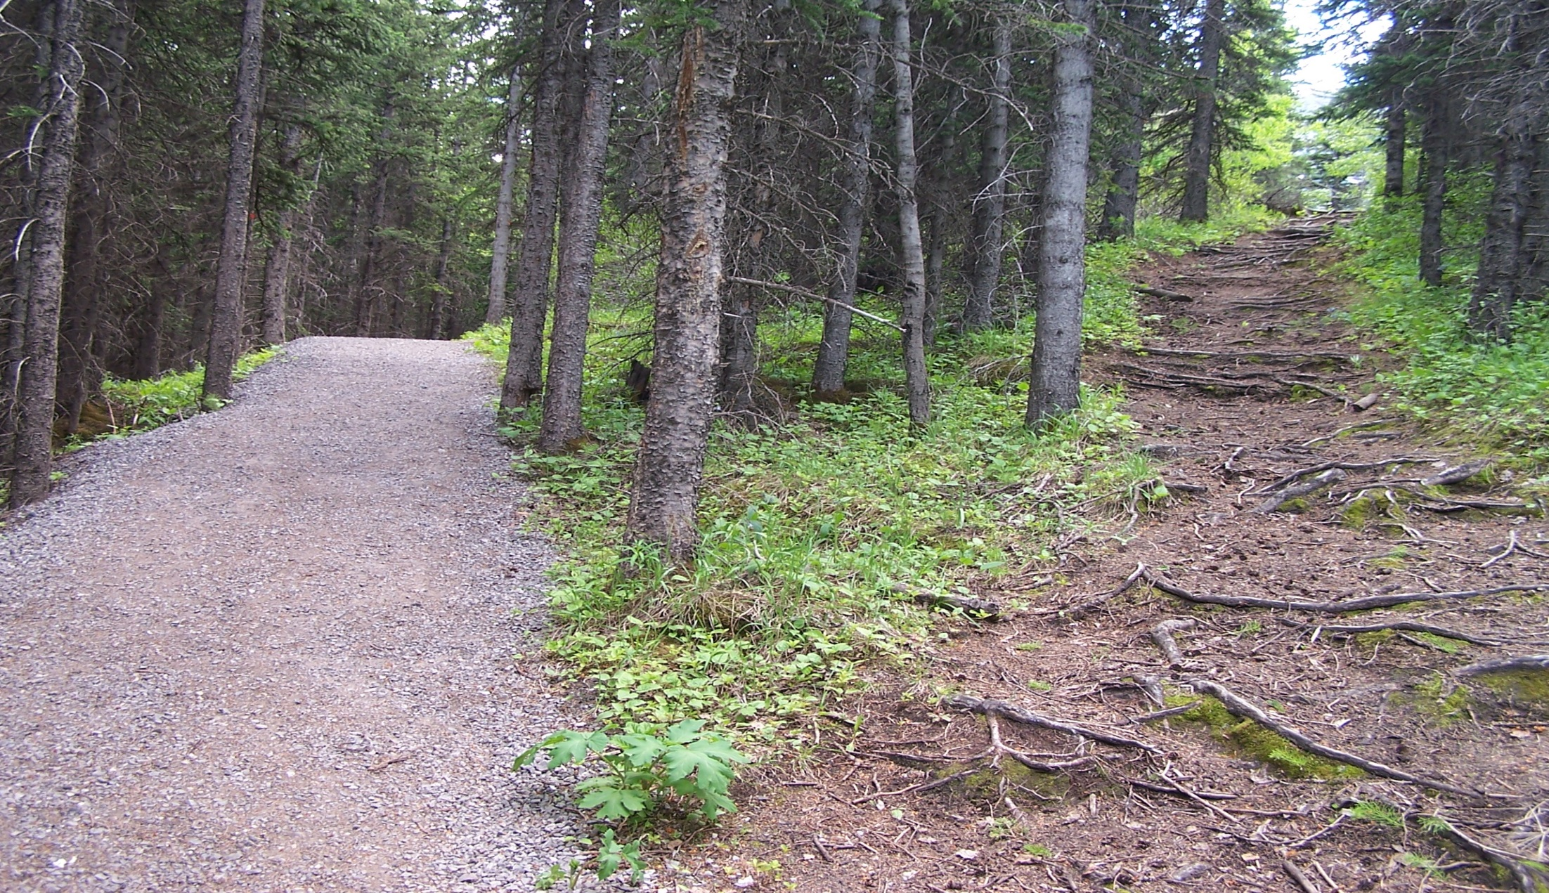
How can sustainable urban flood risk management best be achieved?
Continue on our current path
A different
Urban Flood Risk Future
http://www.conferencesthatwork.com/wp-content/uploads/2013/07/fork-in-the-road-624151138_f1ff60b2db_o.jpg
Notes:
How can sustainable flood risk management best be achieved in urban environments?
(3 slides, 2 minutes)
The great majority of the 5.2 million properties in England that are at risk of flooding are in urban centres and this is also true of the bulk of key assets and infrastructure vulnerable to flooding.
Hence, managing future urban flood risk is crucial to achieving sustainability nationally.
The Adaptation Sub-Committee (ASC) of the Committee on Climate Change reported in October 2015 that the most significant contribution to flood risk reduction will stem from adopting a whole system approach to adaptation. In the context of urban flooding, adopting the whole systems approach advocated by ASC requires that we re-envision planning, design, operation and organisation of both existing and new urban water systems (including flood risk management, waste/stormwater management and water security) to:
ensure satisfactory service delivery under flood, normal and drought conditions;
enhance and extend the useful lives of ageing grey assets by supplementing and integrating
This will require a paradigm shift in the way urban flood risk is managed in the UK – We are at a fork in the road!
This means integrating engineered surface and piped systems with multi-functional Blue/Green infrastructure and urban green spaces to reduce the frequency of flood events and make our cities resilient to those flood events that cannot be prevented.

Slide 4
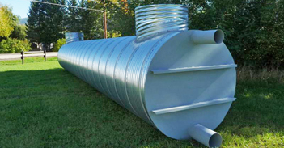
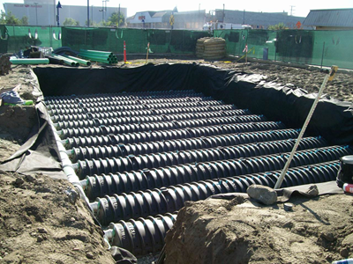
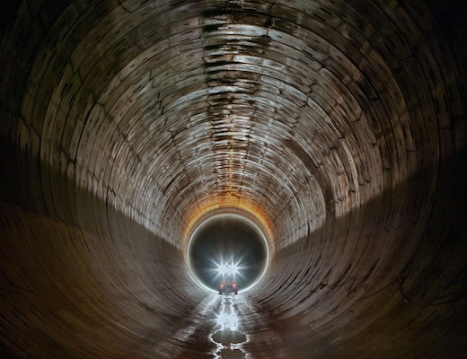
A Grey Future: Bigger pipes, more pipes, huge pipes
Source www.nwl.co.uk
Notes:
A grey future – relying on conventional drainage/storage options and ‘grey approaches’ means bigger tanks, more pipes and huge pipes!

Slide 5
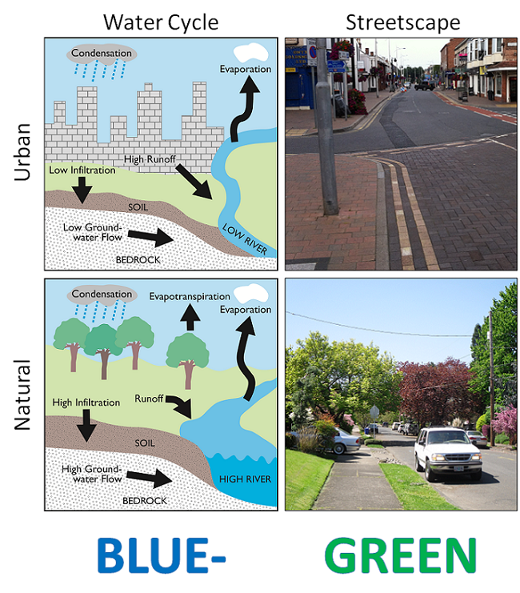
http://en.wikipedia.org/wiki/Blue-Green_Cities
Notes:
What is the alternative to more and bigger pipes?
One option is to use grey and green infrastructure that turns blue when necessary - a Blue-Green City
A BGC aims to recreate a naturally oriented water cycle while contributing to the amenity of the city by bringing water management and green infrastructure together. This is achieved by combining and protecting the hydrological and ecological values of the urban landscape while providing resilient and adaptive measures to deal with flood events. Key functions include restoring natural drainage channels, mimicking pre-development hydrology and improving water quality, reducing imperviousness, and increasing infiltration, surface storage and the use of water retentive plants.
Blue infrastructure includes the ponds, flowing waterways, wet detention basins and wetlands that exist within the drainage network. Green infrastructure refers to natural land and plant based ecological treatment systems and processes. This comprises open spaces, parks, recreation grounds, woodlands, gardens, green corridors, vegetated ephemeral waterways and planted drainage assets that undergo a wet/dry cycle due to runoff flow, e.g. green roofs and street trees. This is illustrated in the diagram on the bottom right as part of the Portland green streets initiative, and contrasts with the fully-urbanised street scape that is illustrated above.
BGI provides a range of services that include; water supply, climate regulation, pollution control and hazard regulation (blue services/goods), crops, food and timber, wild species diversity, detoxification, cultural services (physical health, aesthetics, spiritual), plus abilities to adapt to and mitigate climate change. Such services, and hence the benefits that are directly attributed to them, are often absent where traditional grey infrastructure is used to manage surface water and flooding.
The Blue-Green concept places value on the connection and interaction of blue and green assets and proposes a network of interconnected BGI to convey, treat and manage urban runoff and flooding, while maximising the accrual of multiple benefits. However, the lack of space in highly urbanised catchments may restrict the incorporation and retrofitting of BGI, and hence, grey infrastructure also has a role in the Blue-Green concept, particularly for high magnitude events with a low probability of occurrence.

Slide 6
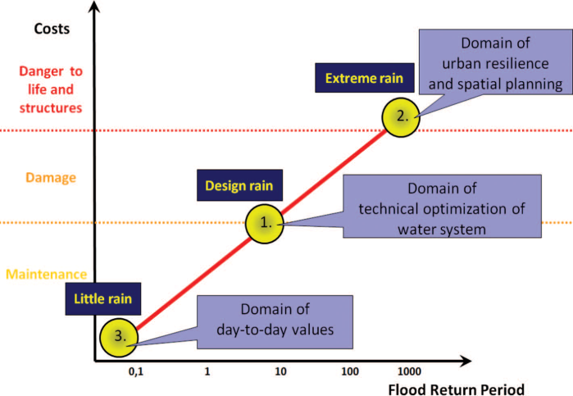
Blue
Condition
If extreme flooding occurs BGI facilitates managed urban conveyance and storage.
Blue-Green infrastructure provides required level of service for flood defence.
Green infrastructure and spaces used on a daily basis by communities and ecosystems.
Green
Condition
Designing for Exceedance
+ Designing for non-flood conditions
= Benefits 24/7, 365 days a year……
Fratini et al.,(2012) Three Points Approach (3PA) for urban flood risk management.
Notes:
Three points approach for urban flood risk management will be adopted by WP3.
The use of the 3PA in practice has proven it to be a communication tool that allows a direct connection to be maintained with the complexity characterising reality in UFRM. It allows water professionals to address the relational complexity characterising UFRM in the context of climate change in a pedagogic manner, thus facilitating the organisation of decision making with the use of transdisciplinarity.
Looking at blue and green conditions (different levels of rainfall, different types of flood risk management strategies are needed, which leads to different costs and benefits)

Slide 7
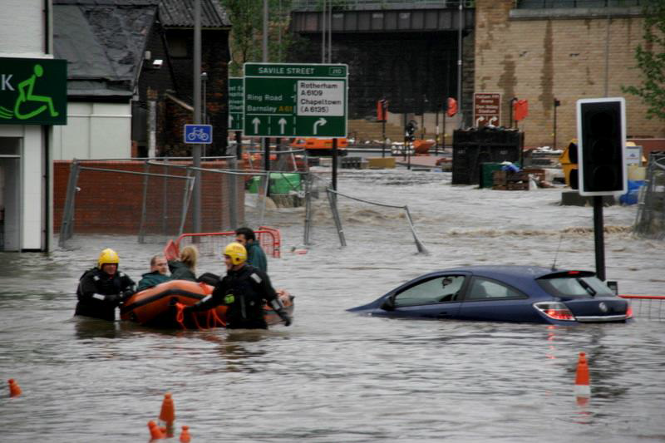
Sheffield: a pilot core city in the
National Flood Resilience Review
https://lynncroweblog.wordpress.com/2015/04/29/flood-defence-protection-in-the-lower-don-valley-sheffield/
Notes:
In Hull we used to say ‘Once in a Sheffield Flood’ as an alternative to ‘Once in a Blue Moon’, to refer to an event that was very rare indeed – clearly this is no longer appropriate.
The EPSRC ‘Blue-Green Cities’ research project investigated alternative urban flood risk management futures for the UK:
Conventional approaches involving bigger pipes, higher walls and deeper channels to convey or store floods,
Innovative approaches that use integrated systems of Blue-Green+Grey to manage flood water sustainably.
A new EPSRC research project (Achieving Urban Flood Resilience in an Uncertain Future) is investigating how Blue-Green+Grey systems can make UK Cities resilient to flooding given that it can’t be prevented entirely.

Slide 8
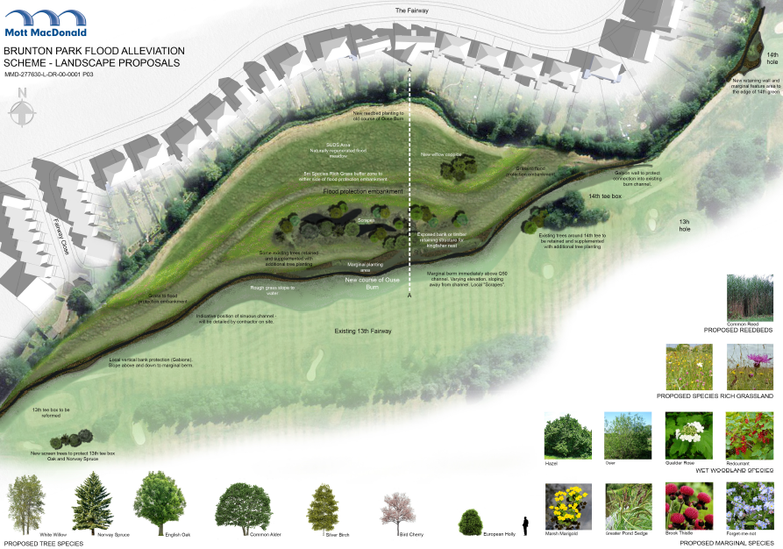
Blue-Green Options: Social and Environmental performance

Slide 9
How can urban planning and flood risk management deliver innovation?

Slide 10
Barriers to innovation in Newcastle upon Tyne
Blue-Green Systems
Notes:
The barriers fall into two categories: those specific to Blue-Green infrastructure (illustrated in blue), and those experienced by other water and environmental infrastructure projects (illustrated in brown), including grey approaches to flood risk management.
In the context of these interviews and the statements that the respondents were giving, we found that the majority of the barriers associated with lack of knowledge, education and awareness, the reluctance to support novel approaches and change practice, maintenance and adoption, and identifying and quantifying/monetising the multiple benefits, were specific to Blue-Green infrastructure projects.
This suggests that strategies to overcome the barriers need to be geared specifically to the Blue-Green barriers.
Sheffield benefits from being home to the Pennine Water Group at Sheffield University – it can and should use the LAA and Advocacy coalition approaches outlined in next slides.

Slide 11
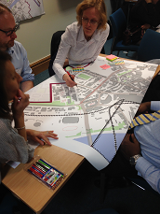
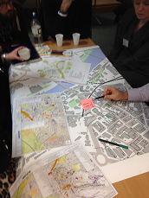
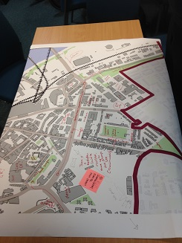
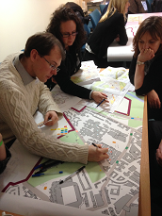
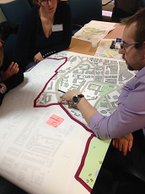
The Newcastle Learning and Action Alliance
‘Blue-Greening’ the urban core – a master-planning workshop
Notes:
The objective of the Newcastle LAA is to promote the blue-green vision for Newcastle and realise it by recognising, and utilising, windows of opportunity for potentially influencing the strategies of decision makers. The BG vision was negotiated by the LAA members towards the start of this initiative.
There were multiple meetings over 3 years.
Early on the LAA decided to explore how to ‘Blue-Green the Newcastle urban core’. The objective was to help identify the potential types and locations suitable for Blue-Green retrofit. The LAA used A0 maps of sections of the core and asked the groups to annotate the maps with their suggestions. The suggestions were then compiled into one large map of a Blue-Green urban core.

Slide 12
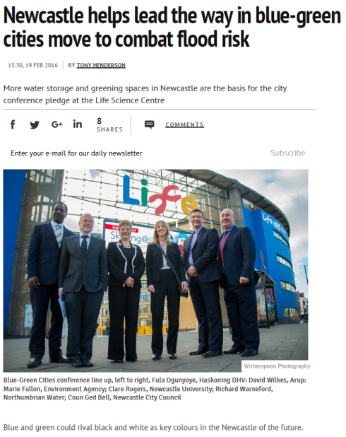
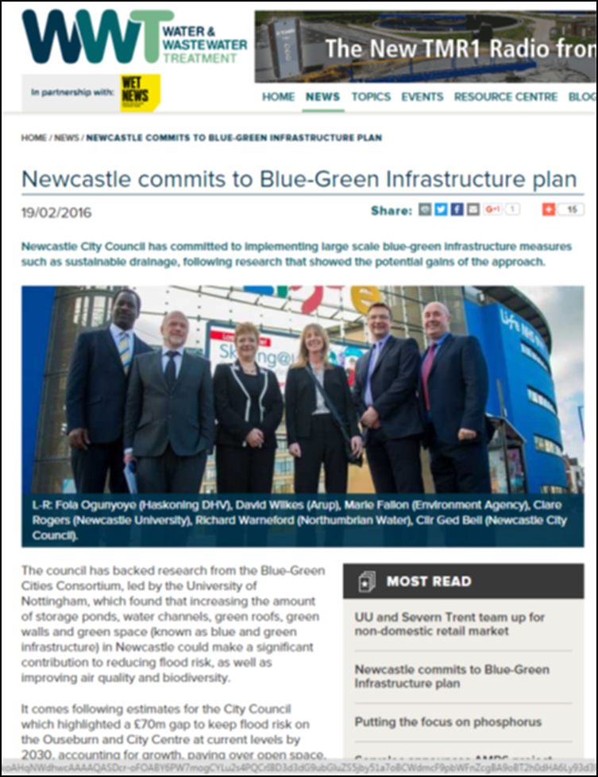
Notes:
Experience in Newcastle demonstrates the efficacy of the LAA approach – on 18 February this year Newcastle City, Northumbrian Water, Newcastle University, the Environment Agency, Arup and Haskoning signed a pledge to make Newcastle a Blue-Green City and this now written into the 2016 version of the City’s ‘Local Flood Risk Management Plan’.
Recent research has established that social and institutional barriers to innovation are more problematic than scientific and technical barriers but progressive cities like Glasgow, Birmingham and Newcastle have been able to overcome these barriers and innovate by bringing urban planning, development and flood management professionals together and allowing them to build trust, share knowledge and re-envision UFRM across institutions and outside their job descriptions¹. in ‘Learning and Action Alliances’ ²and through ‘Advocacy Coalitions’.³
1. Lafinhan, D. 2014. The changing governance of UK flood management policies 1998-2010: a comparative analysis of local approaches in Scotland and England. Thesis submitted to the University of Nottingham for the degree of Doctor of Philosophy, 289p.
2. Ashley, R., Blanskby, J., Newman, R., Gersonius, B., Poole, A., Lindley, G., Smith, S., Ogden, S., Nowell, R., 2012. Learning and Action Alliances to build capacity for flood resilience. Journal of Flood Risk Management 5, 14-22. DOI: 10.1111/j.1753-318X.2011.01108.x.
3. Weilbe, C. M., et al. (2011) A quarter century of the advocacy coalition framework: an introduction to the special issue. Policy Studies Journal, 39(3), 349-360.

Slide 13
Can ‘models of self-financing’ fund innovative flood risk management?
Notes:
The NFRR is right to recommend transformative change in UFRM to: “unlock the economic, aesthetic and ecological value of the city’s water at the same time as making (Sheffield) an even nicer place to live.” and NFRR will, “be working with Sheffield to enable the city to identify development of a type that will beautify the city-scape, unlock opportunities for urban regeneration and fit with local development priorities. Our aim is for Sheffield, and thereafter the other Core Cities, to own and lead this resilient (re)development.” (NFRR, p25).
For this approach to work, Sheffield and other core cities must get the sums right and at the moment the sums are likely to be wrong for two reasons:
1. Underestimating the benefits of ‘damages avoided’ through achieving flood resilience, which can be addressed using the ‘Flood Footprint’ economic analysis (next slide).
2. Challenges of reliably valuing the non-flood, co-benefits of sustainable, Blue-Green approaches to achieving flood resilience (slides on BeST and the Multiple Benefits GIS-based Tool).

Slide 14
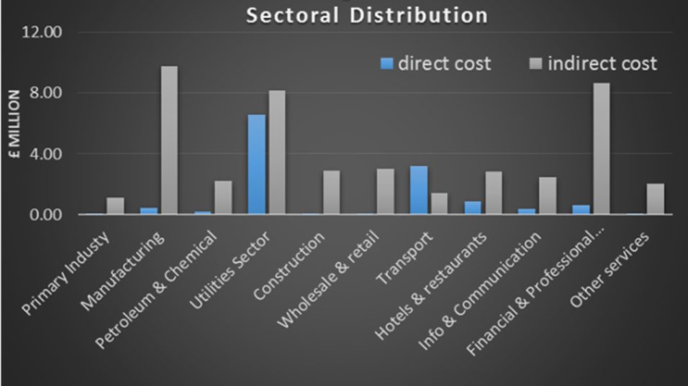
2012 Flood Footprint: Total damage = ~£78 million
Direct Damages = ~£34 M Indirect Damages = ~£44 M
Manufacturing, Utilities and Business sectors most affected
Mendoza-Tinoco, D. and Guan, D. 2015. Flood Footprint assessment Fact sheet, download from: http://www.bluegreencities.ac.uk/bluegreencities/documents/floodfootprintassessment-dm.pdf
Notes:
Disruption of supply chains, constraints on labour moement/availability and capital productive capacity after the flooding carried an indirect loss for Newcastle event which accounts £44 m. The, the flood footprint was £78m in total, which more than double the ‘direct losses’ conventionally attributed to the 2012 ‘Toon Monsoon’.
Flood Footprint analysis suggests it took over 14 months for the city’s economy to recover back to the pre-flooding condition.
The true cost of urban flooding in the UK is probably double that estimated using conventional economic analyses. We know this from research led by Professor Dabo Guan that uses the ‘Flood Footprint’ method to identify the INDIRECT costs of floods through, for example disruption of supply chains. These costs are particularly large in the manufacturing, utilities and business sectors. As a result the ‘cost-avoided’ benefits of sustainable UFRM are currently underestimated by a factor of perhaps 50%.
Reference:
Mendoza-Tinoco, D. and Guan, D. 2015. Flood Footprint assessment Fact sheet, download from: http://www.bluegreencities.ac.uk/bluegreencities/documents/floodfootprintassessment-dm.pdf

Slide 15


BeST(Benefits of SuDS Tool)
W045d BeST–User Manual
Release version
1 July 2015
https://ciria.sharefile.com/share#view/9e79a9ddac8044b2
Notes:
BeST is free to download and use.

Slide 16
Blue-Green
Benefit Mapping Tool:
Benefit Potential
http://www.bluegreencities.ac.uk/bluegreencities/publications/multiple-benefit-toolbox.aspx
Flood Reduction and multiple co-benefits: the Advantages of Blue-Green Infrastructure in Arthurs’s Hill, Newcastle
Notes:
A novel GIS tool for evaluating the multiple benefits (benefit intensity and benefit profile) and benefit dependencies of BG infrastructure for urban water management has been successfully piloted in Portland, Oregon, illustrating the potential for the tool to help prioritise and co-design the benefits from the outset of project planning.
Unlike buried pipes and storage tanks, Sustainable Drainage Systems (SuDS) and Blue-Green Infrastructure don’t generate benefits only during floods (which are, thankfully rare and don’t last long).
These multiple co-benefits are not conventionally recognised in UK FRM. CIRIA BeST and Blue-Green Cities Benefits Tool show how non-flood benefits accrue through time – equalling or exceeding the flood-related benefits (costs-avoided) when floods are managed using integrated systems of Blue-Green and Grey infrastructure. They also show that non-flood benefits are not only financial (higher property values, higher productivity) but also environmental (improved ecosystem services, reduced heat island effect) and social (improved public health, increased wellness).
We need to recognise and value the ‘Blue-Green Advantage’ offered by innovative UFRM when considering the whole-life costs and multiple-benefits of alternative flood risk management strategies.¹ This is the key to successful localism in UFRM.
1. O’Donnell, E. 2016. Evaluating the benefits and identifying the beneficiaries of Blue-Green infrastructure to encourage institutional collaboration and community action. Final Report to Northumbrian Water Limited under project number 512672, University of Nottingham, 99p.

Slide 17
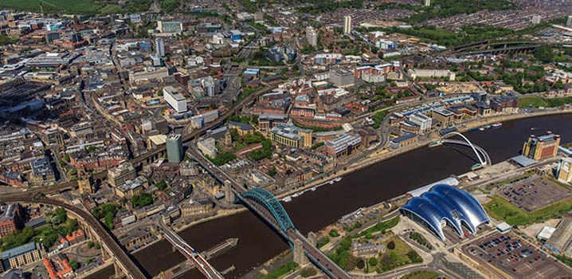
“what is required is a fundamental change in how we view flood management, from flood defence where we protect ourselves to one of resilience, living with and making space for water and the opportunity to get “more from less” by seeing all forms of water as providing multiple benefits.”
Take Home Message
Commission of Inquiry into flood resilience of the future titled ‘Living with water’, March 2015. All Party Group for Excellence in the Built Environment, House of Commons, London SW1A 0AA: p. 32, para. 3.
Notes:
Take home messages:
1. “what is required is a fundamental change in how we view flood management, from flood defence where we protect ourselves to one of resilience, living with and making space for water and the opportunity to get “more from less” by seeing all forms of water as providing multiple benefits.”
Commission of Inquiry into flood resilience of the future titled ‘Living with water’, March 2015. All Party Group for Excellence in the Built Environment, House of Commons, London SW1A 0AA: p. 32, para. 3.
2. UK Cities can achieve flood resilience and simultaneously become more liveable by exploiting the Blue-Green Advantage!
The findings reported here reinforce the RGS - UK flood risk management Policy recommendations. The following numbered sections of the RGS Report (and associated recommendations) pertain particularly to achieving Urban Flood Resilience in the UK:
3. Flood defences and residual risk
8. Adaptation to Climate change
9. Roles and responsibilities
10. Scale and spatial planning
11. Financial aspects of flood risk management
12. Awareness and understanding among public, media and Parliamentarians
13. Resilience and recovery

Slide 18
The Blue-Green Cities Research Consortium was supported by:
  Engineering and Physical Sciences Research Council
  Northern Ireland Rivers Agency
  Environment Agency
  Newcastle City Council
  Northumbrian Water Limited
bluegreencities.ac.uk
EPSRC Grant EP/K013661/1

