Slide 1







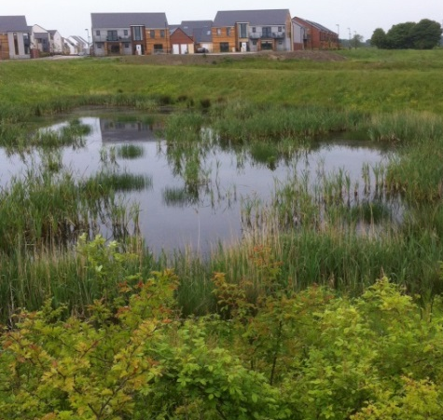
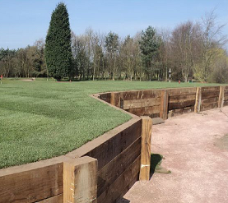
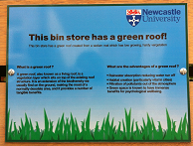

Overcoming uncertainties and barriers to Blue-Green infrastructure
Emily O’Donnell
www.urbanfloodresilience.ac.uk Urban Flood Resilience @BlueGreenCities

Slide 2
Barriers to sustainable drainage
Physical science (preconceptions)
Technical / technological
Institutional
Legal / regulatory
Managerial / organisational
Political
Monetary
Social – ‘hearts and minds’
Resistance to change = institutional inertia
Technical problems can be overcome and, in most cases, the economical and social constraints rather than purely hydrological considerations will influence the final shape of the chosen solution (Niemczynowicz, 1999)

Slide 3
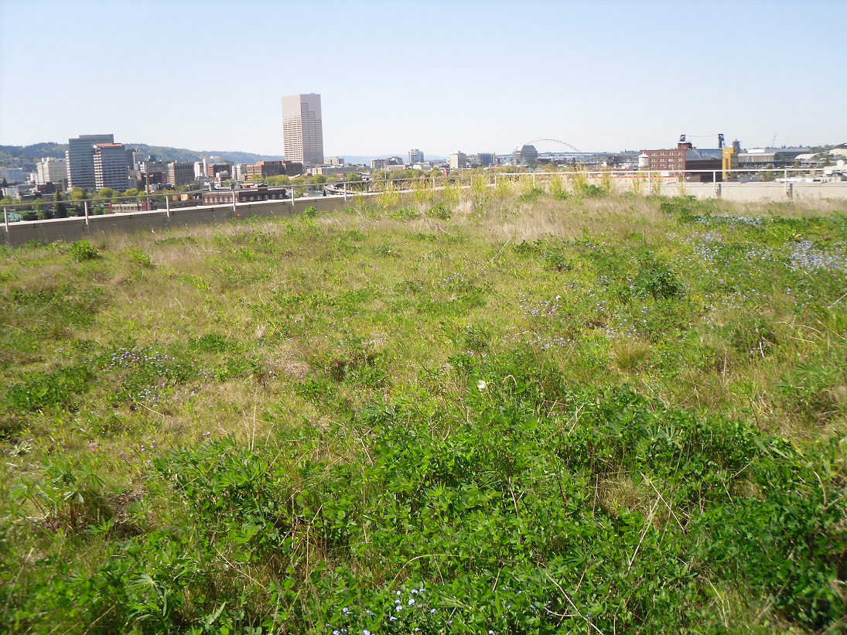
International case studies: Portland, Oregon USA
‘Grey to Green’ initiative (2008-2013)
32,200 new street trees, 867 green street planters, 398 eco-roofs, culvert removal, land acquisition, river and floodplain restoration
City estimate:
investment of $9 million in GI for stormwater management saves ratepayers (who are currently paying for the $1.4 billion ‘Big Pipe’ project) $224 million in CSO maintenance and repair costs

Slide 4
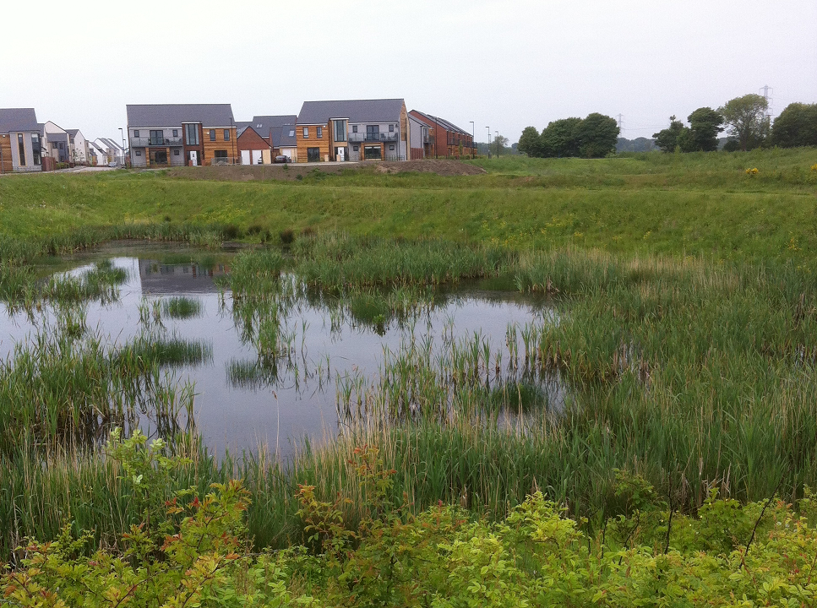
International case studies: Newcastle, UK

Slide 5
Barriers to Blue-Green infrastructure
Physical science
Downscaling climate projections
Natural hazards
Climate change impacts
Modelling
Asset maintenance and performance
Lack of available space
Future land use and climate

Slide 6
Barriers to Blue-Green infrastructure
Socio-political
Legislation, regulations
Adoption of assets
Lack of knowledge
Ineffective communi-cation
‘Novelty’
Issues with partnership working
Funding and costs
Culture, public perception
Identifying multiple benefits
Competing priorities

Slide 7
Barriers to Blue-Green infrastructure (Newcastle)
“I think initially one of the major sort of frustrations and issues were around data sharing”
“I definitely think that there’s still a traditional approach in place, and that people aren’t thinking about going towards more blue-green technologies”
“Communication is a barrier, work pressure limits the amount of time people have, and so trying to educate them about a new approach that may offer efficiency and value for money is hard”

Slide 8
Overcoming barriers
Many of the barriers may be difficult to overcome – systemic and embedded within organisational cultures, practices and processes
(Brown and Farrelly, 2007)

Slide 9
Overcoming barriers – top 5 strategies
1
Promote multifunctional space and identify, quantify and monetise the multiple benefits
2
Improve education and communication, raise awareness, community engagement
2
Partnership working from the project outset
4
5
Changes in legislation, regulations, industry standards, planning guidelines
Exemplars (examples of best practice, local – international)

Slide 10
Promote multifunctional space and identify, quantify and monetise the multiple benefits
“Then if it is similar in cost, but you can highlight all these other benefits that link with our sustainability strategy, our air quality work, then straight away they would be happy to sign it off as a project”
“They [SuDS] could potentially be designed to perform those sort of dual functions.”

Slide 11
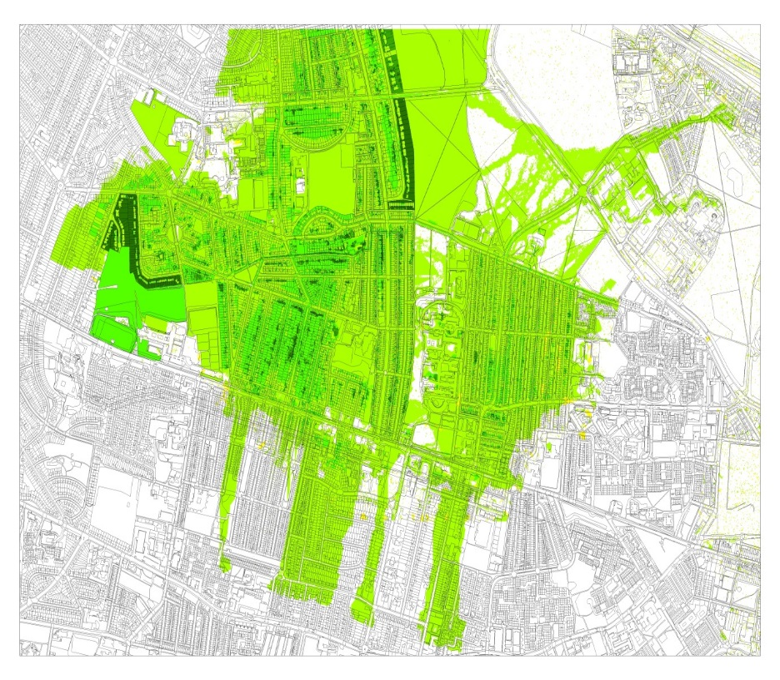
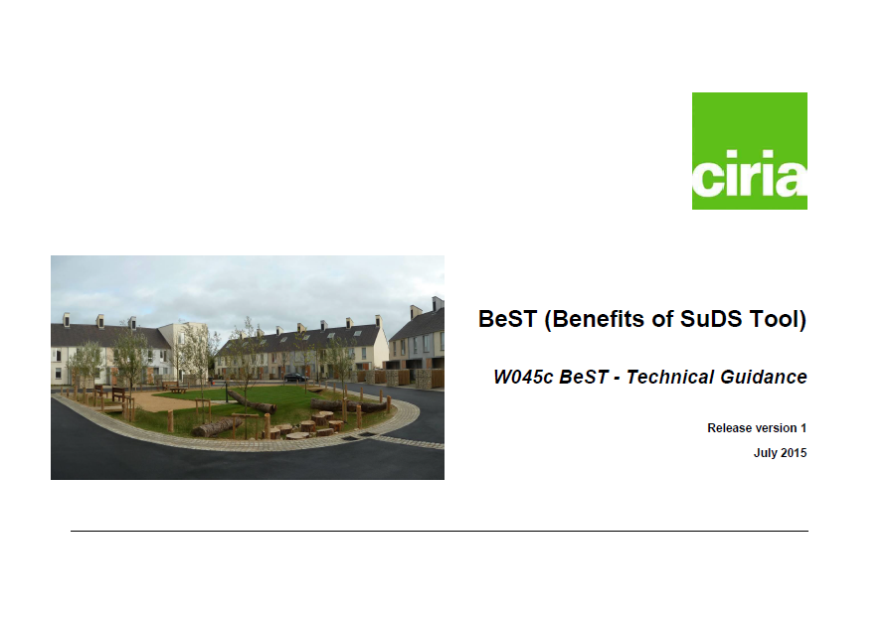

CIRIA Benefits of SuDS Tool (BeST) and Blue-Green Cities Multiple Benefit Toolbox

Slide 12
Improve education and communication, raise awareness, community engagement
Placing emphasis on decision makers
and communities to take action
“I think educating decision makers specifically because it’s quite a new concept and none of the policy documentation that is their guide to decision making really pushes that”
If the community get together and run the initiative themselves it’s got far more power than the council going down wagging our finger at people saying you should have water butts down here”

Slide 13
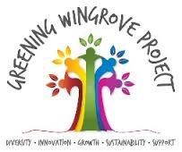
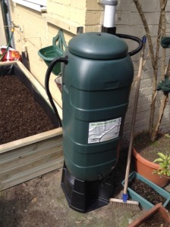
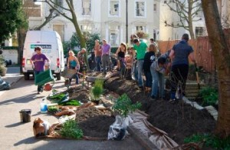
Community engagement – Newcastle Greening Wingrove
New Vertical Veg Street demonstration project using sustainable drainage
Images from www.greeningwingrove.org.uk

Slide 14
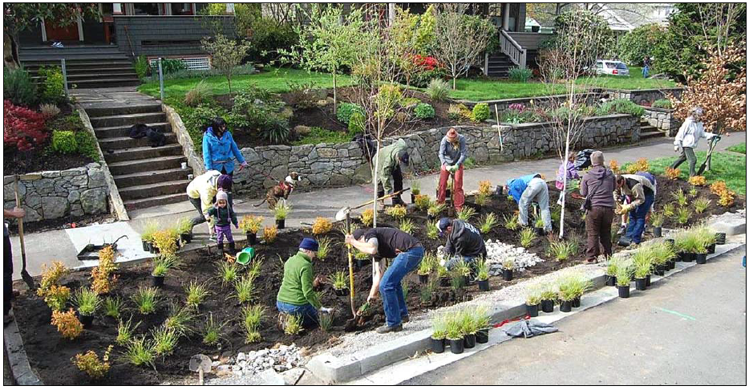
Community engagement – Portland green street planting and stewardship
Many of the barriers may be difficult to overcome – systemic and embedded within organisational cultures, practices and processes
(Brown and Farrelly, 2007)
Image: Oregon Department of Environmental Quality 2010.

